Slide 1

iValueU
A mindfulness app to bring you joy and serenity
Brought to you by Martijn Meeldijk [ST20186553]

Slide 2
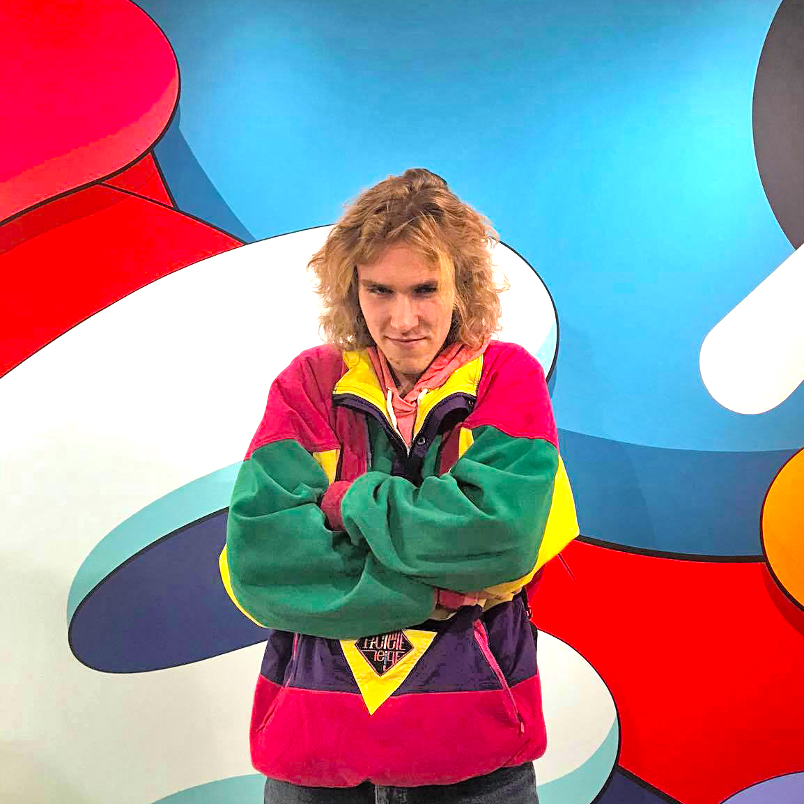
Martijn Meeldijk
Your host
Brought to you by Martijn Meeldijk [ST20186553]

Slide 3
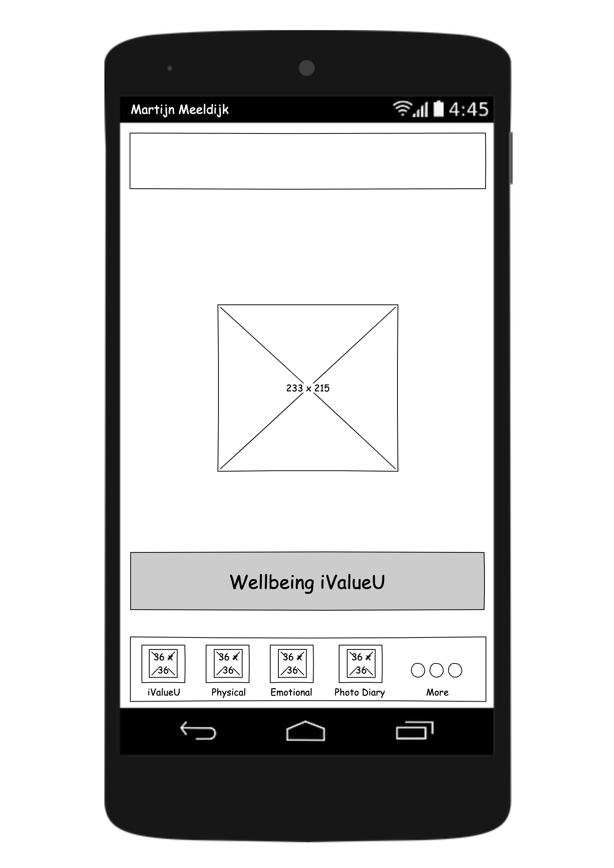
The Homescreen
The starting point of our app.

Slide 4
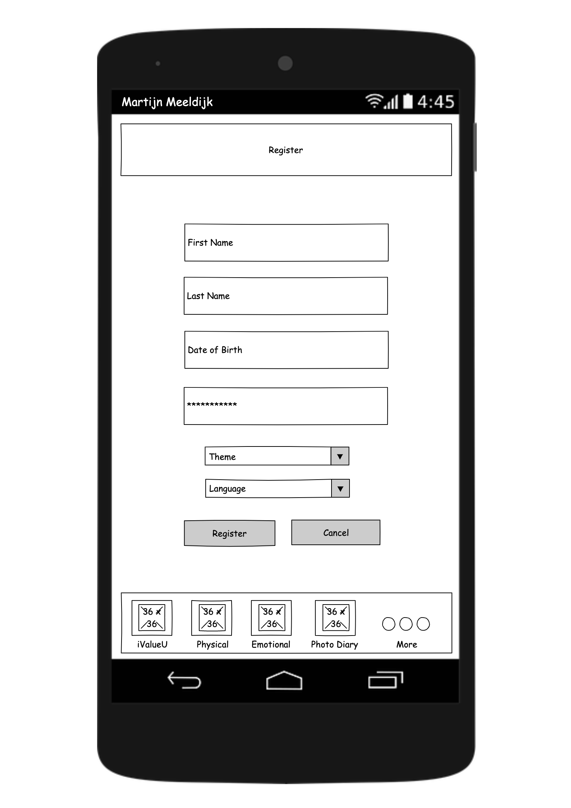
First time here?
Create an account.
The original version didn’t have this.

Slide 5
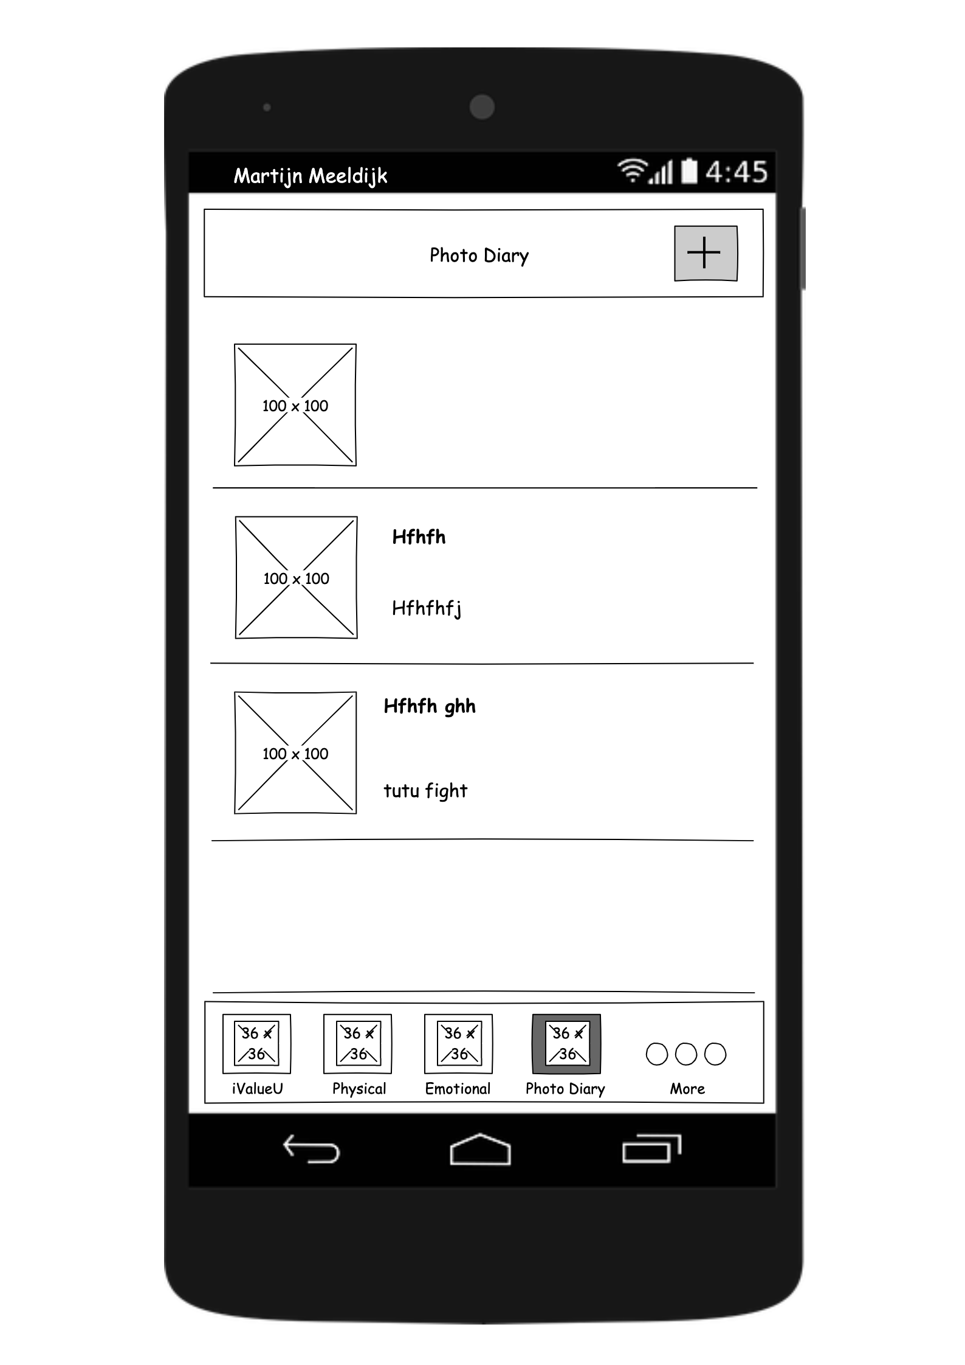
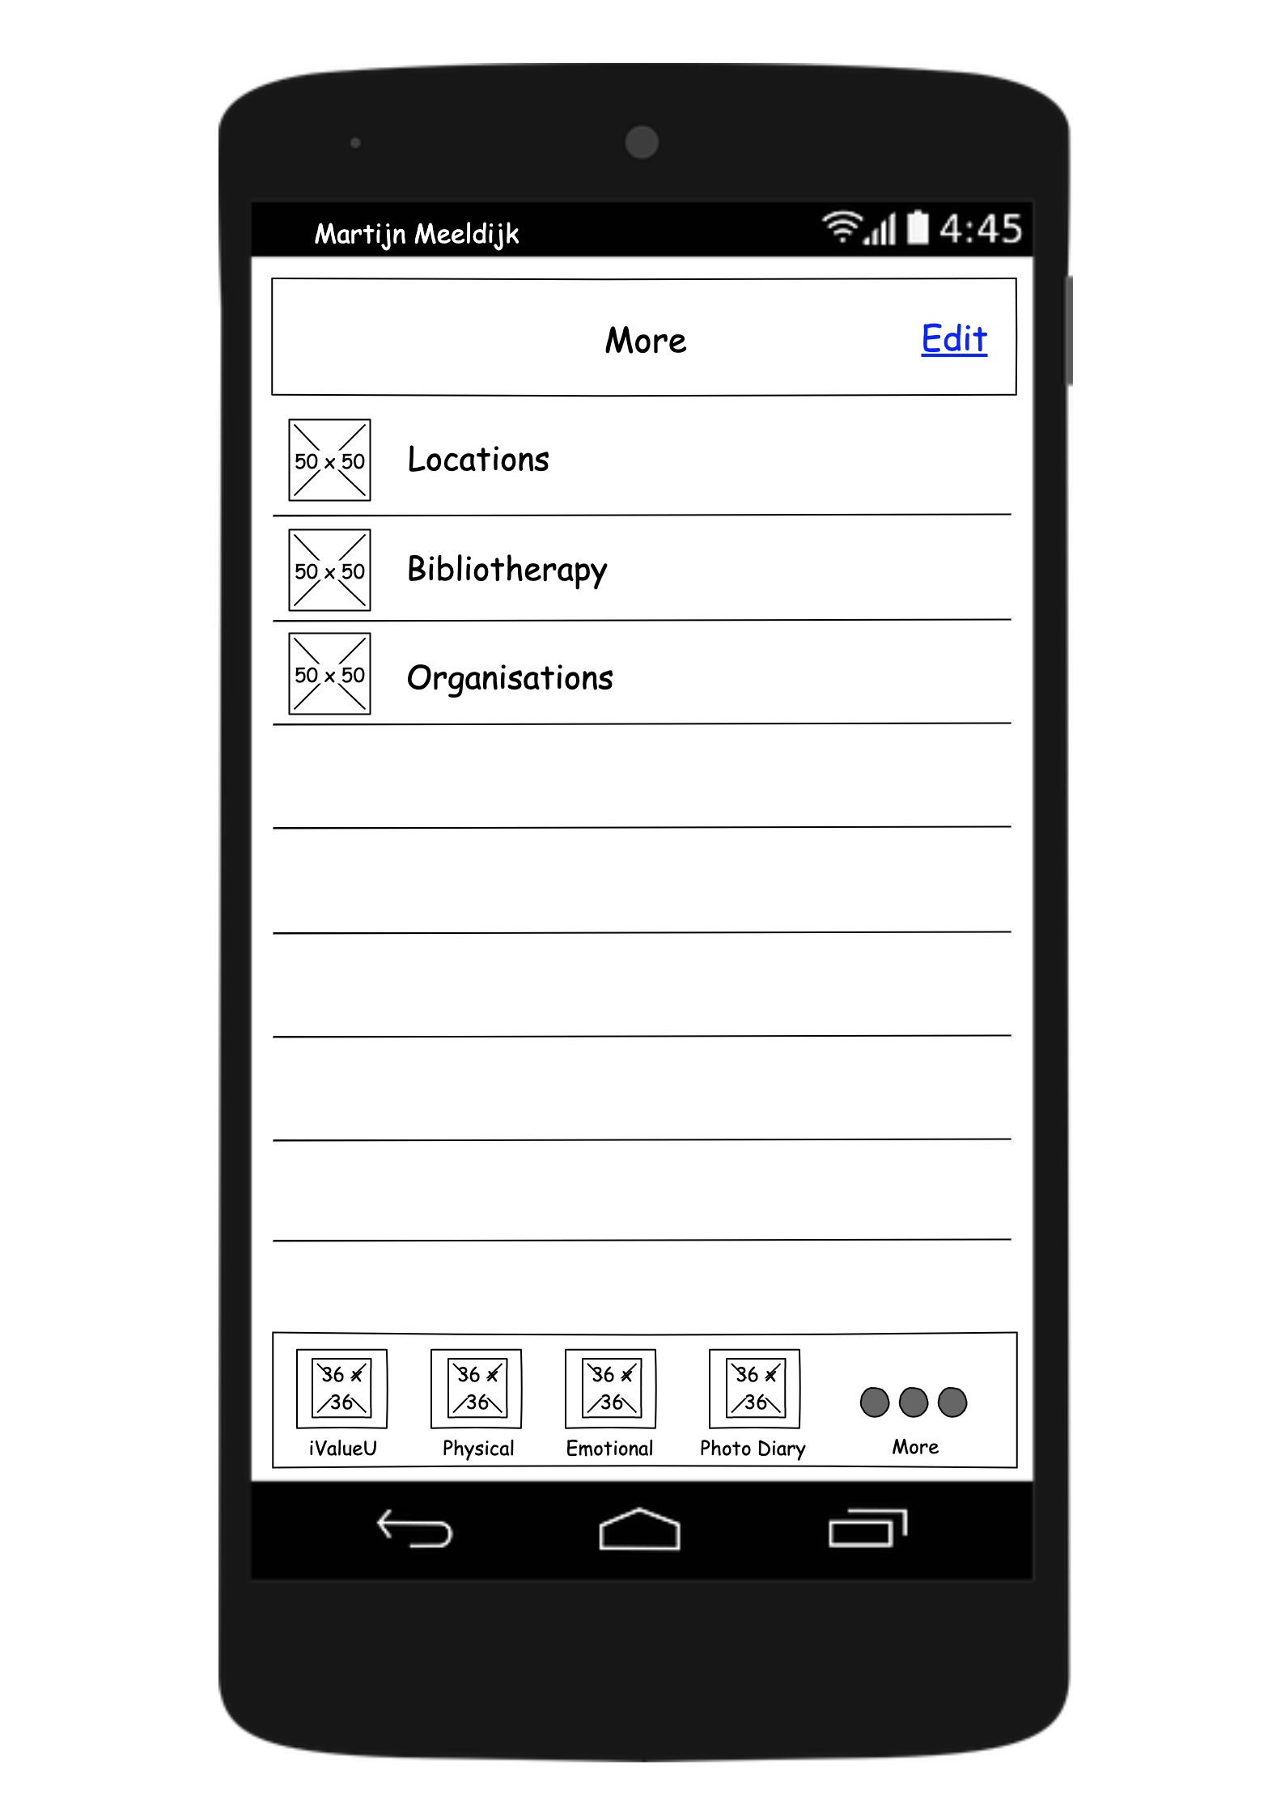
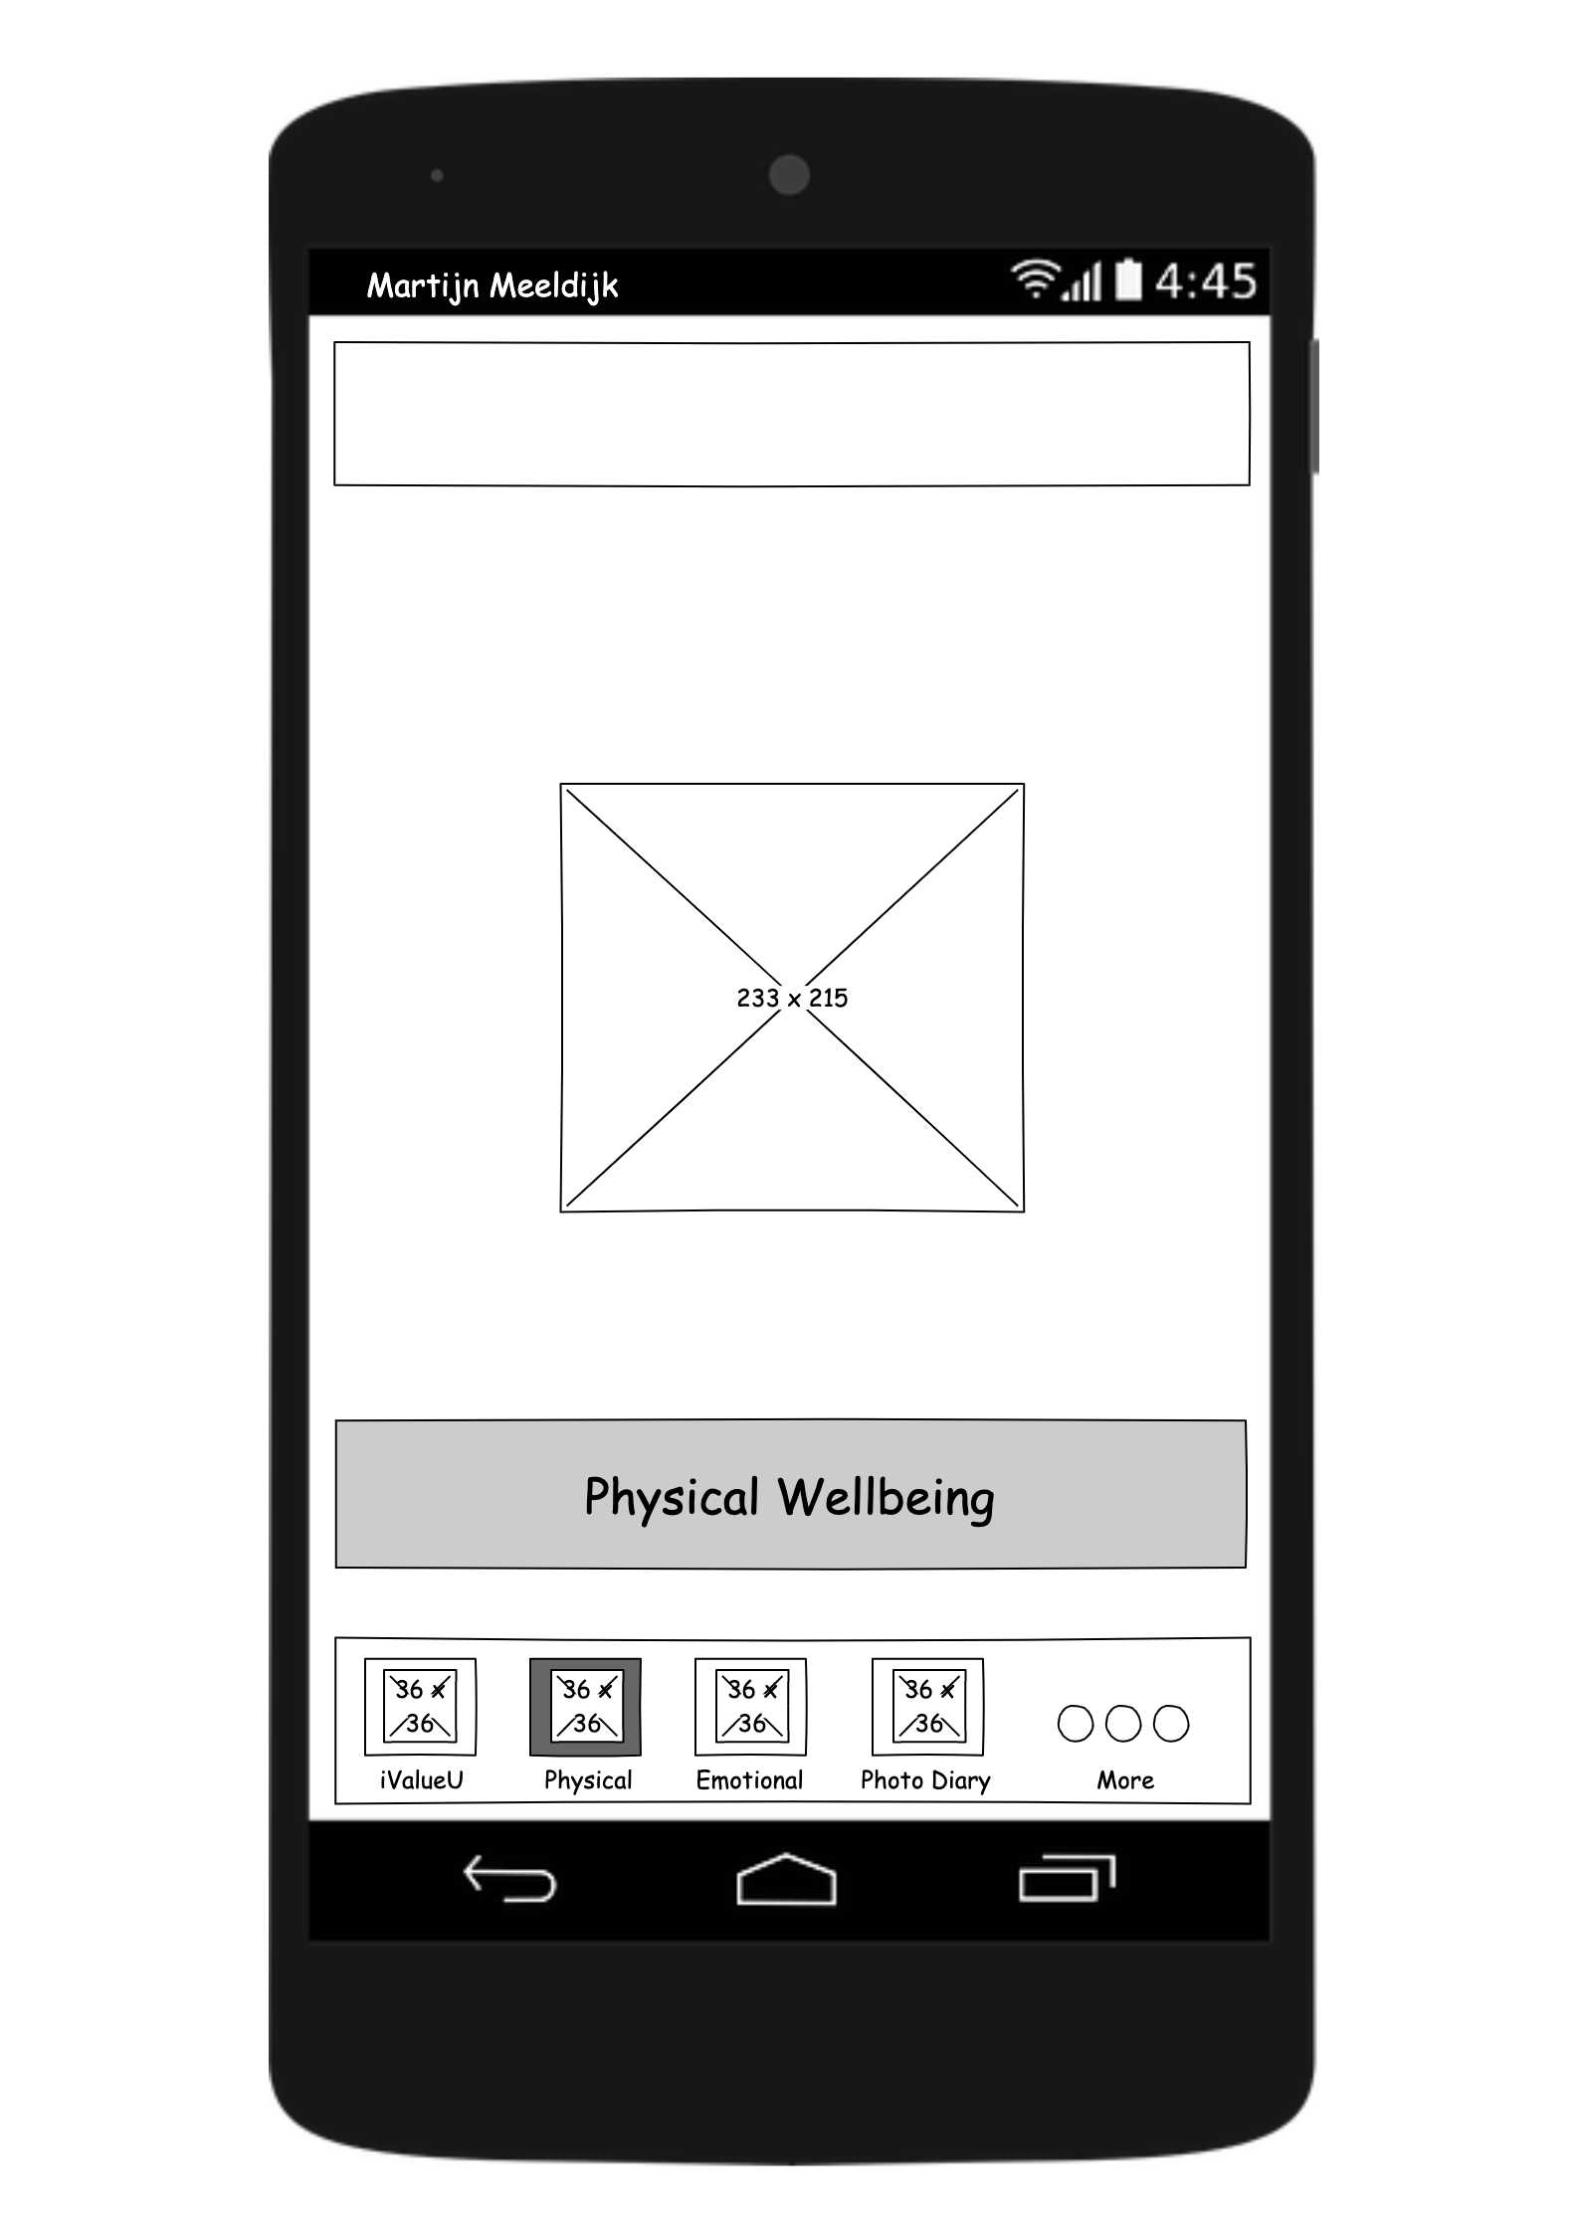
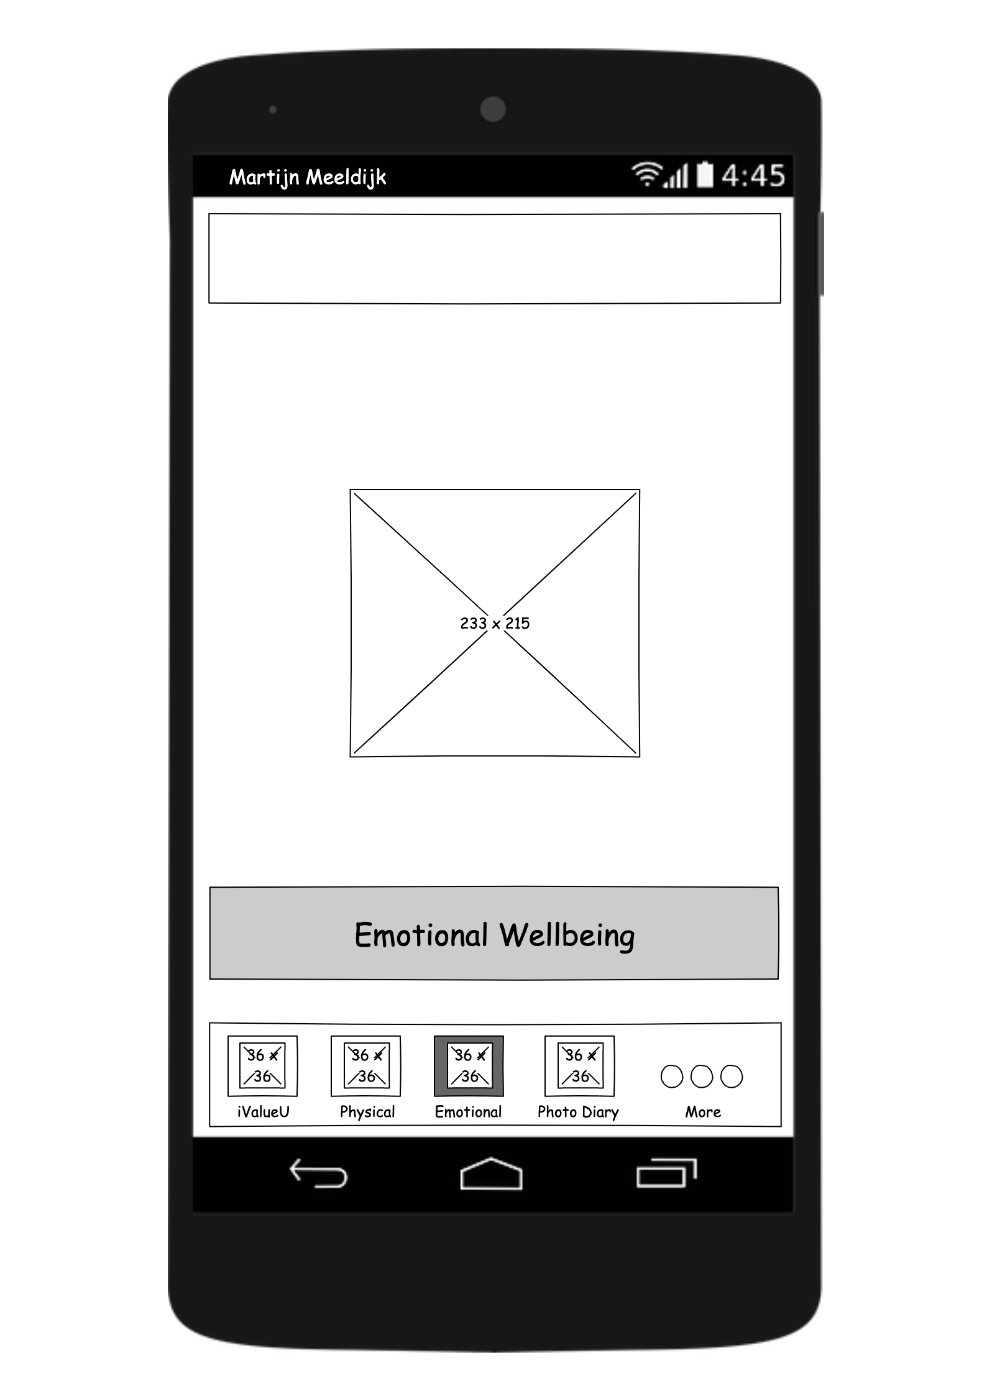
Functions
Homepage

Slide 6

Physical

Slide 7
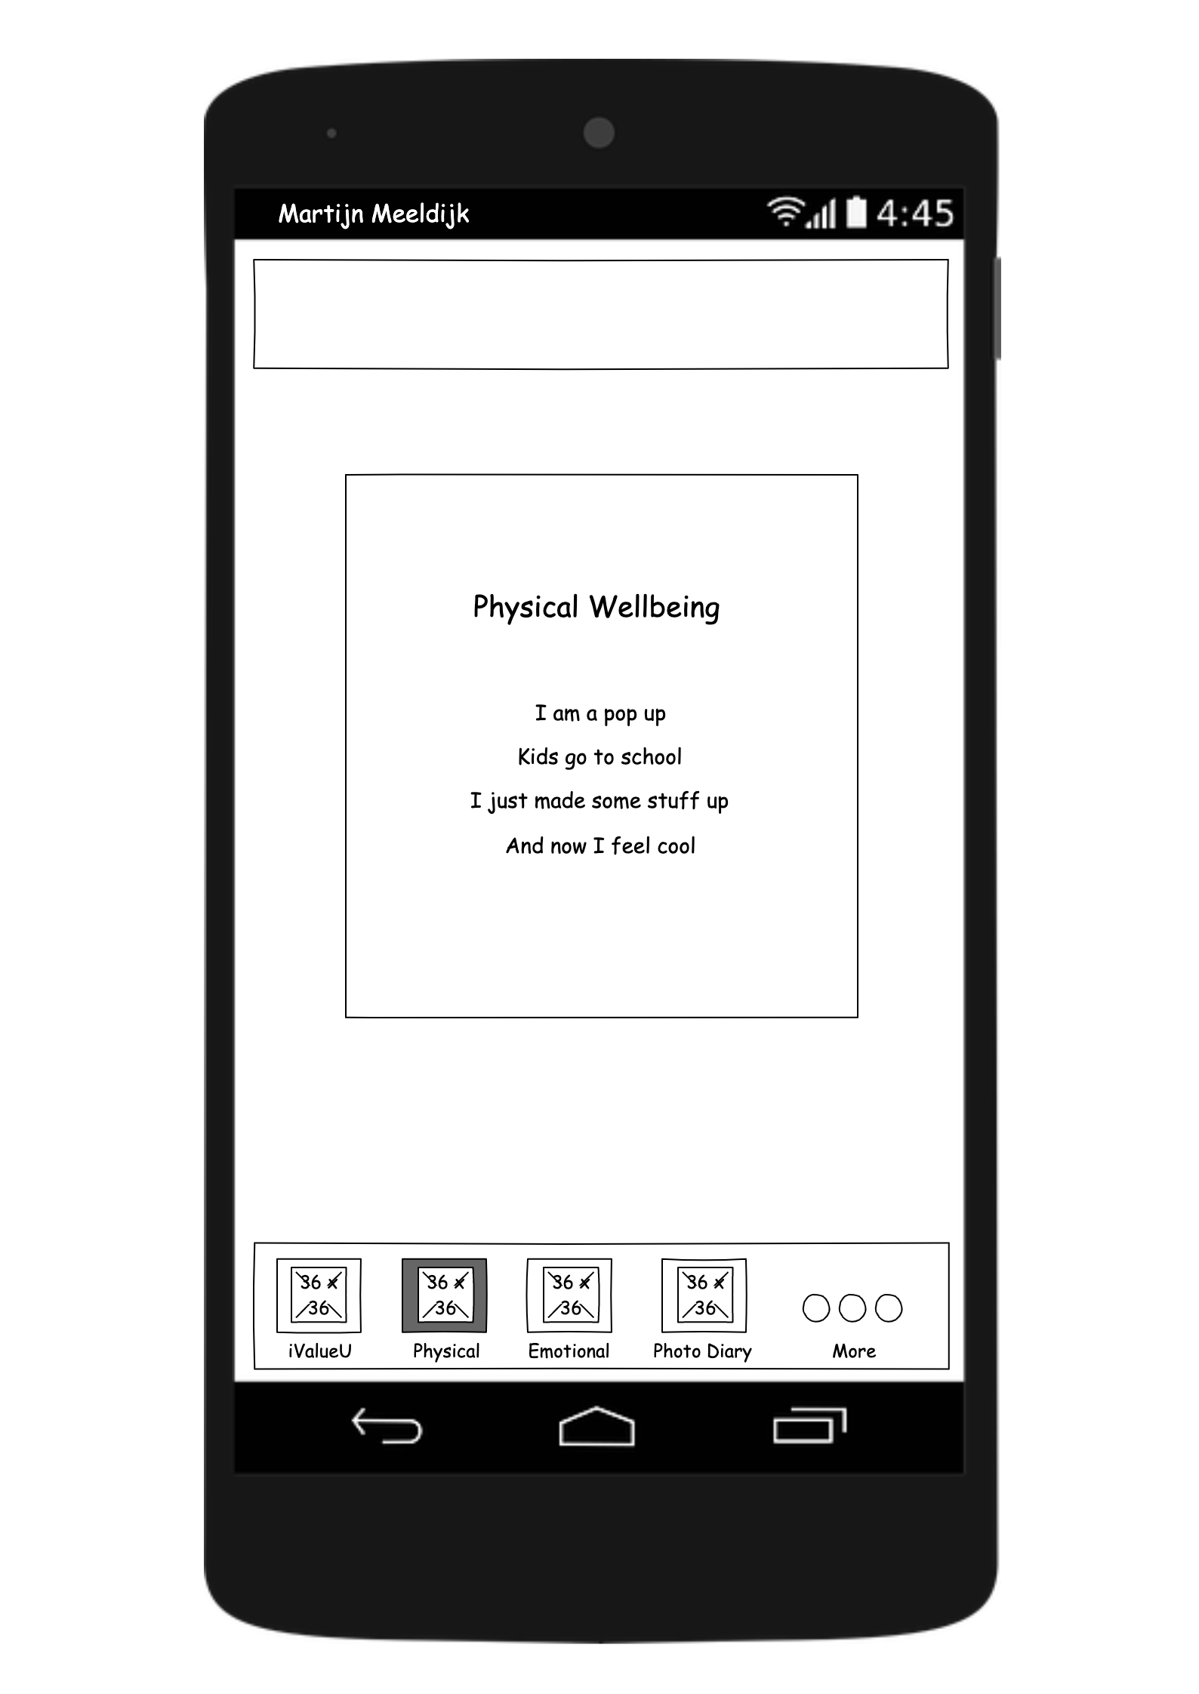
Physical
Upon entering the Physical tab, you’ll be greeted by a welcome message

Slide 8
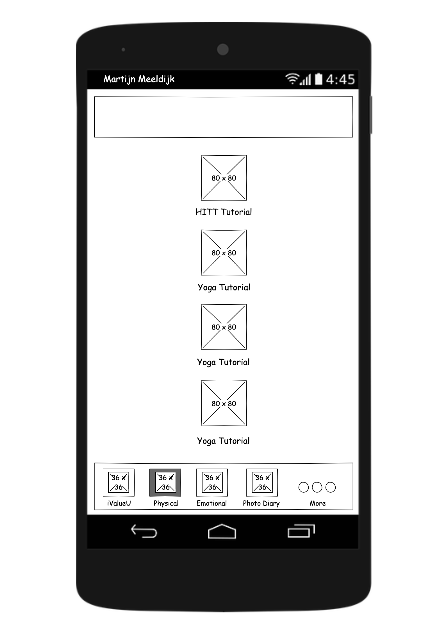
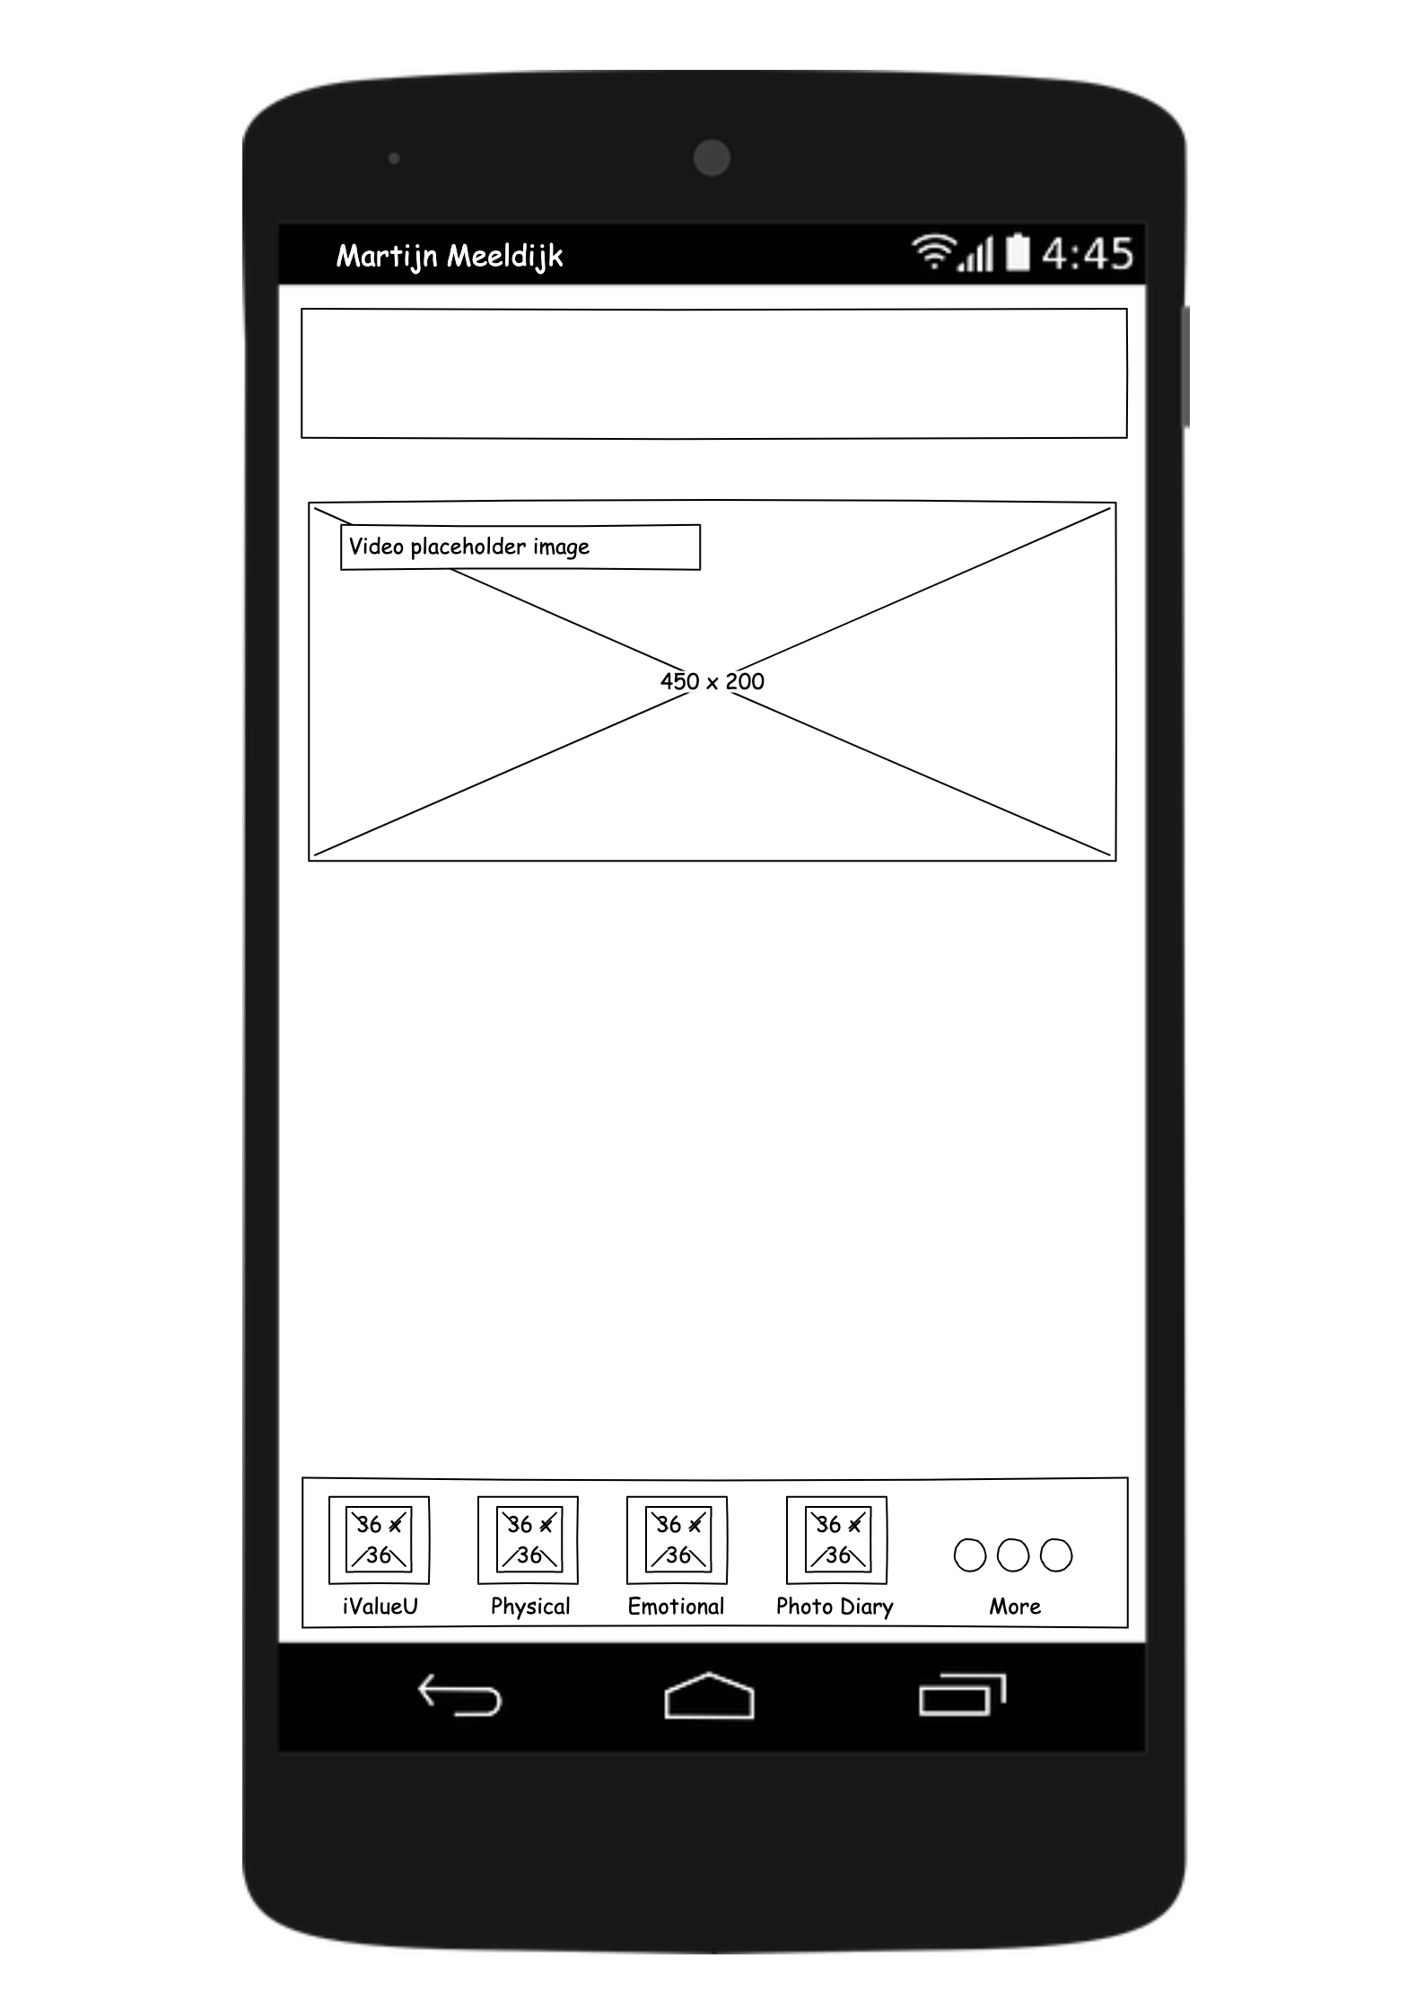
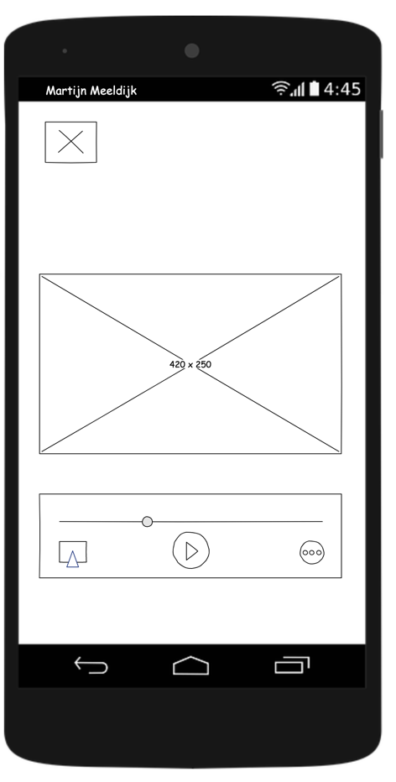
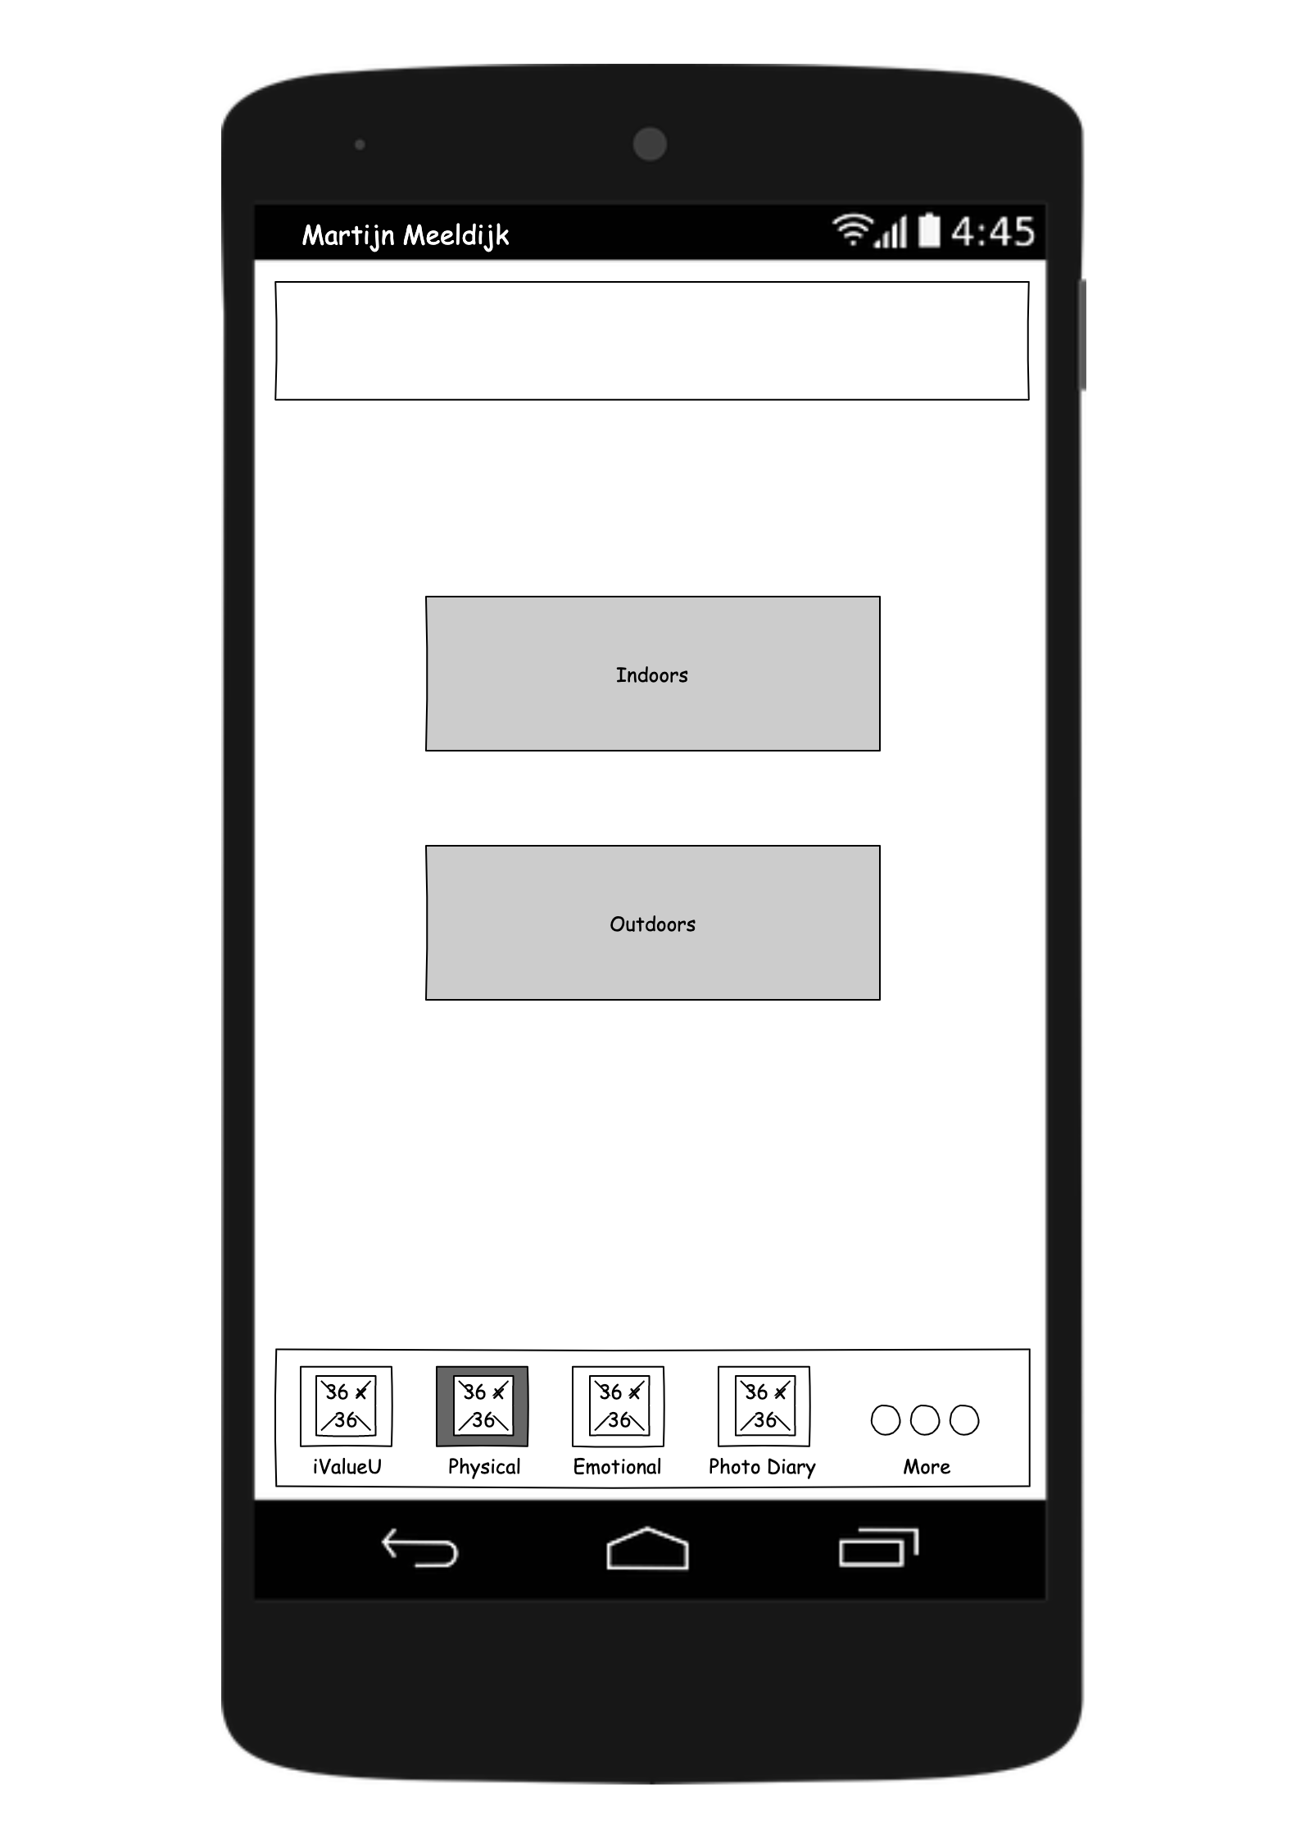
Physical functions
In the new version, you can choose between indoor or outdoor activities

Slide 9

Emotional

Slide 10
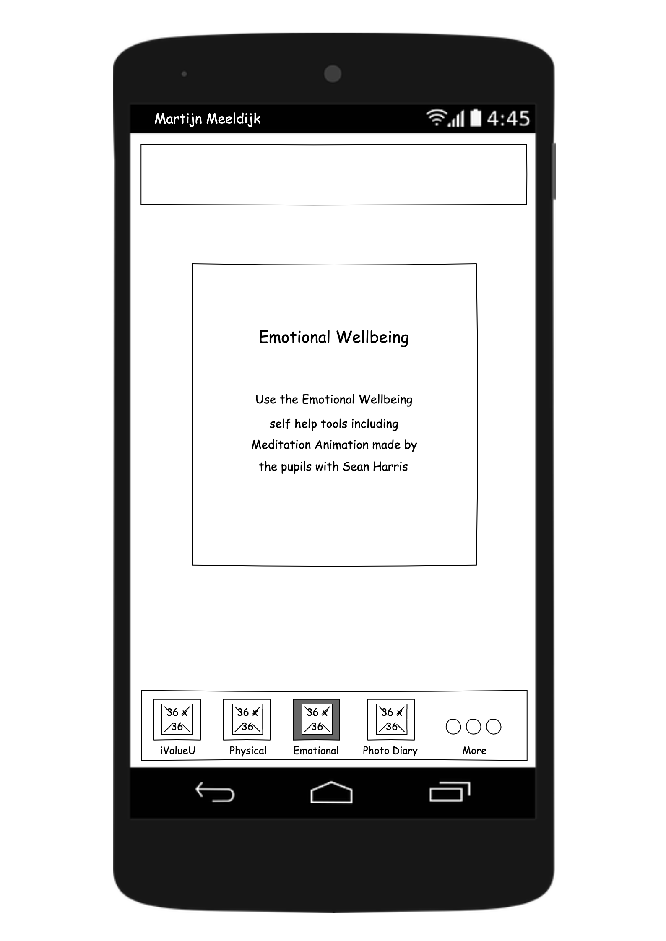
Emotional
Upon entering the Emotional tab, you’ll be greeted by a welcome message

Slide 11
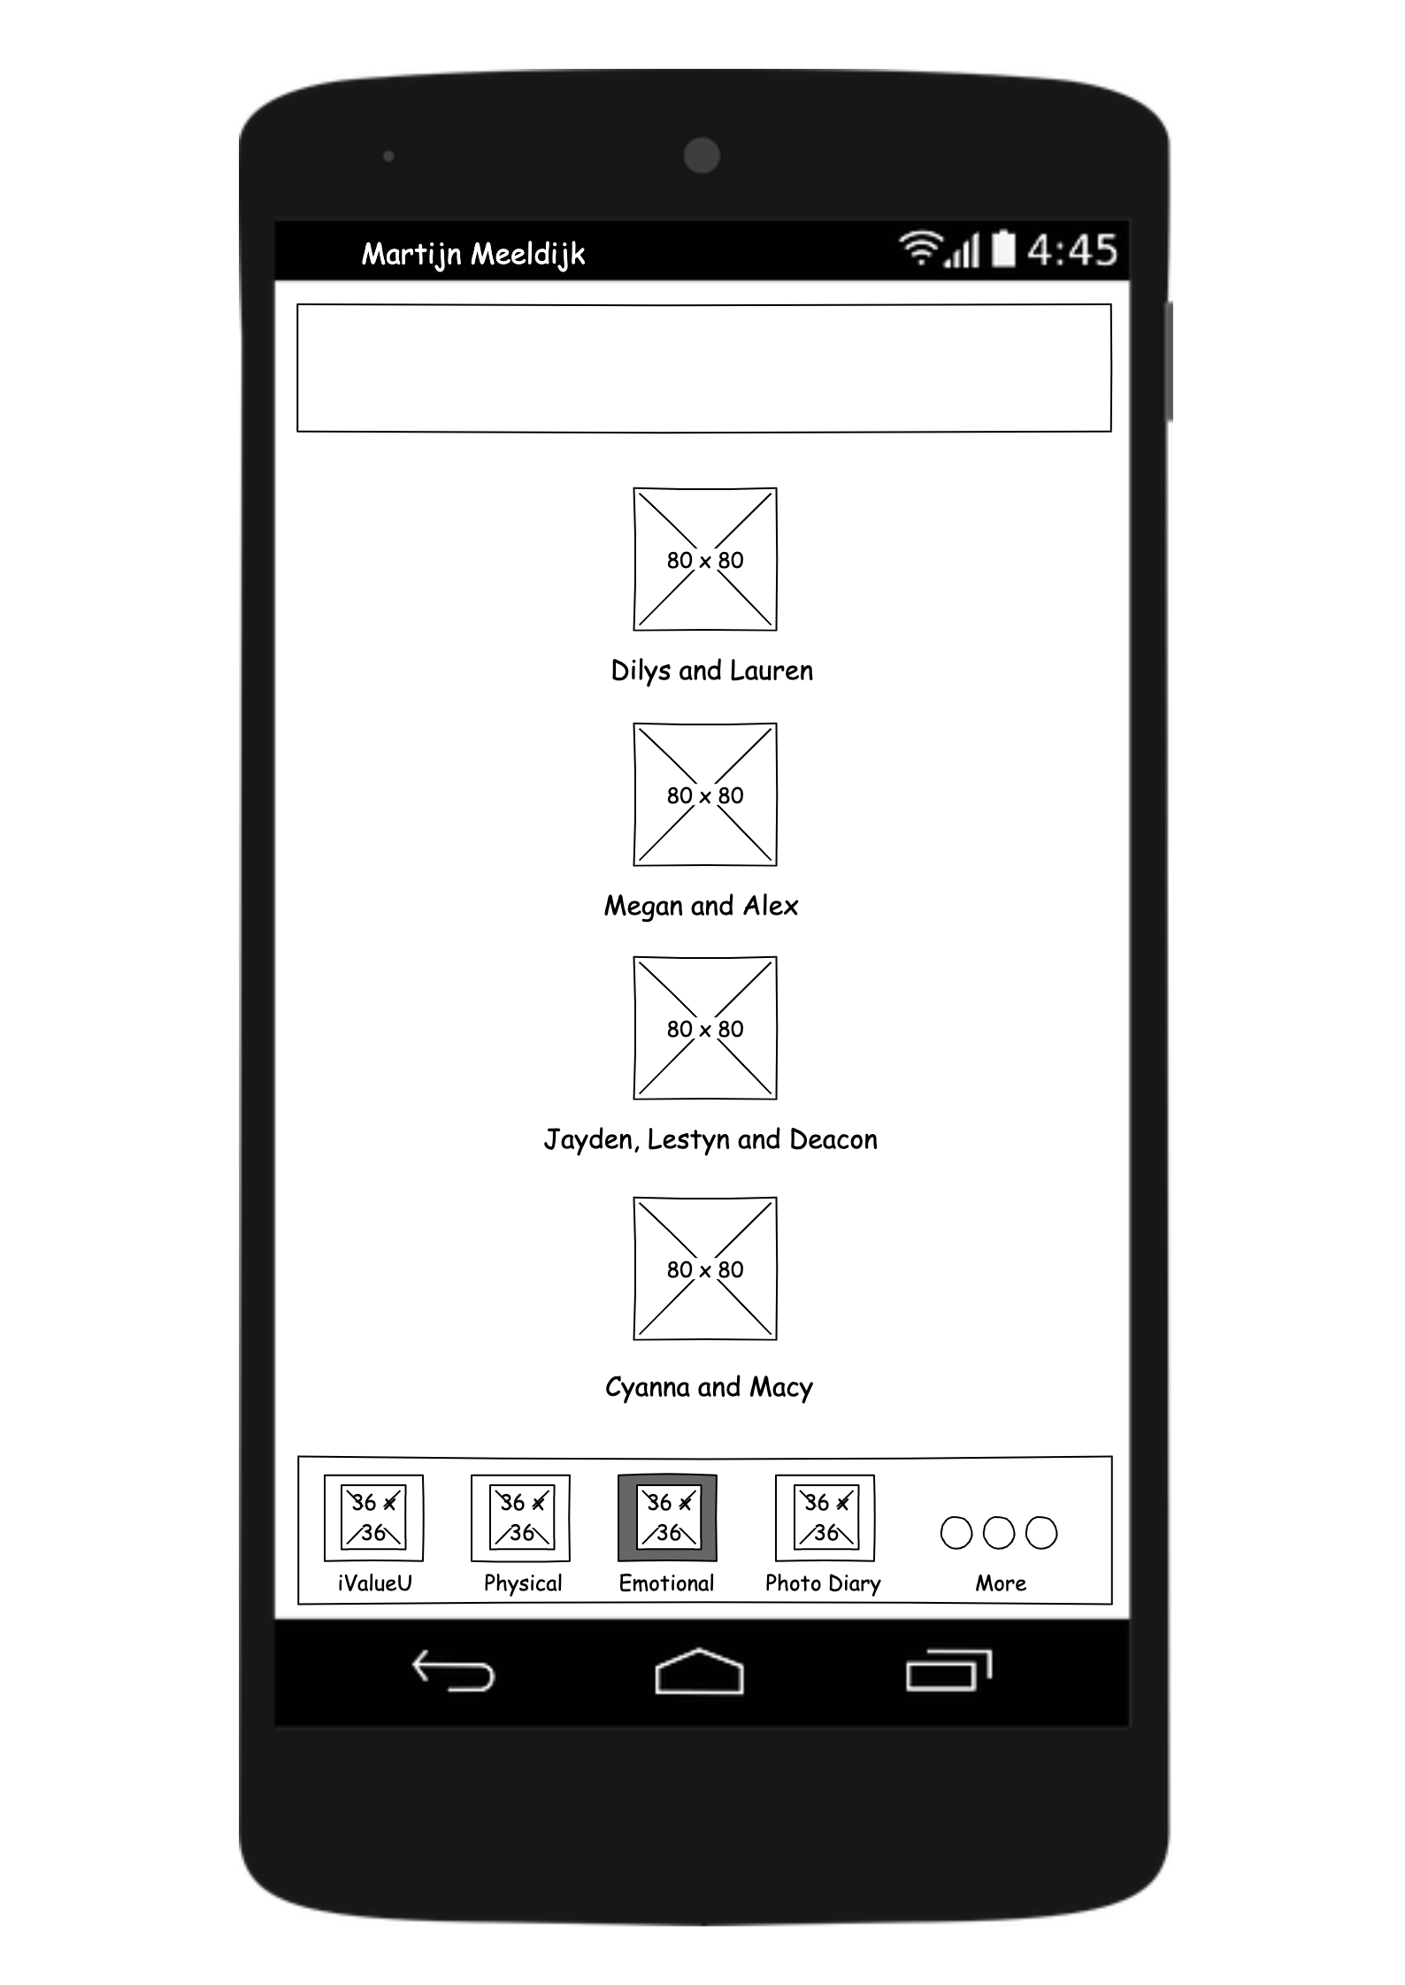


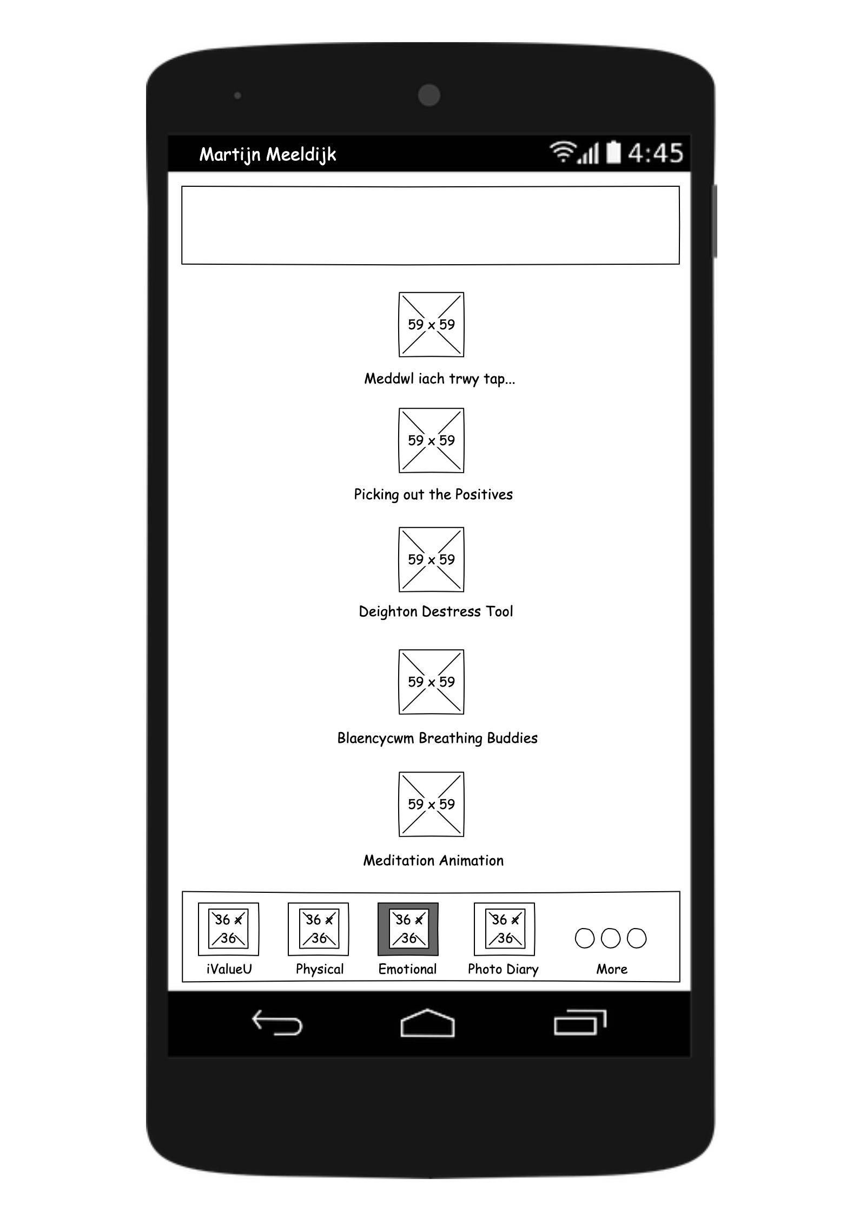

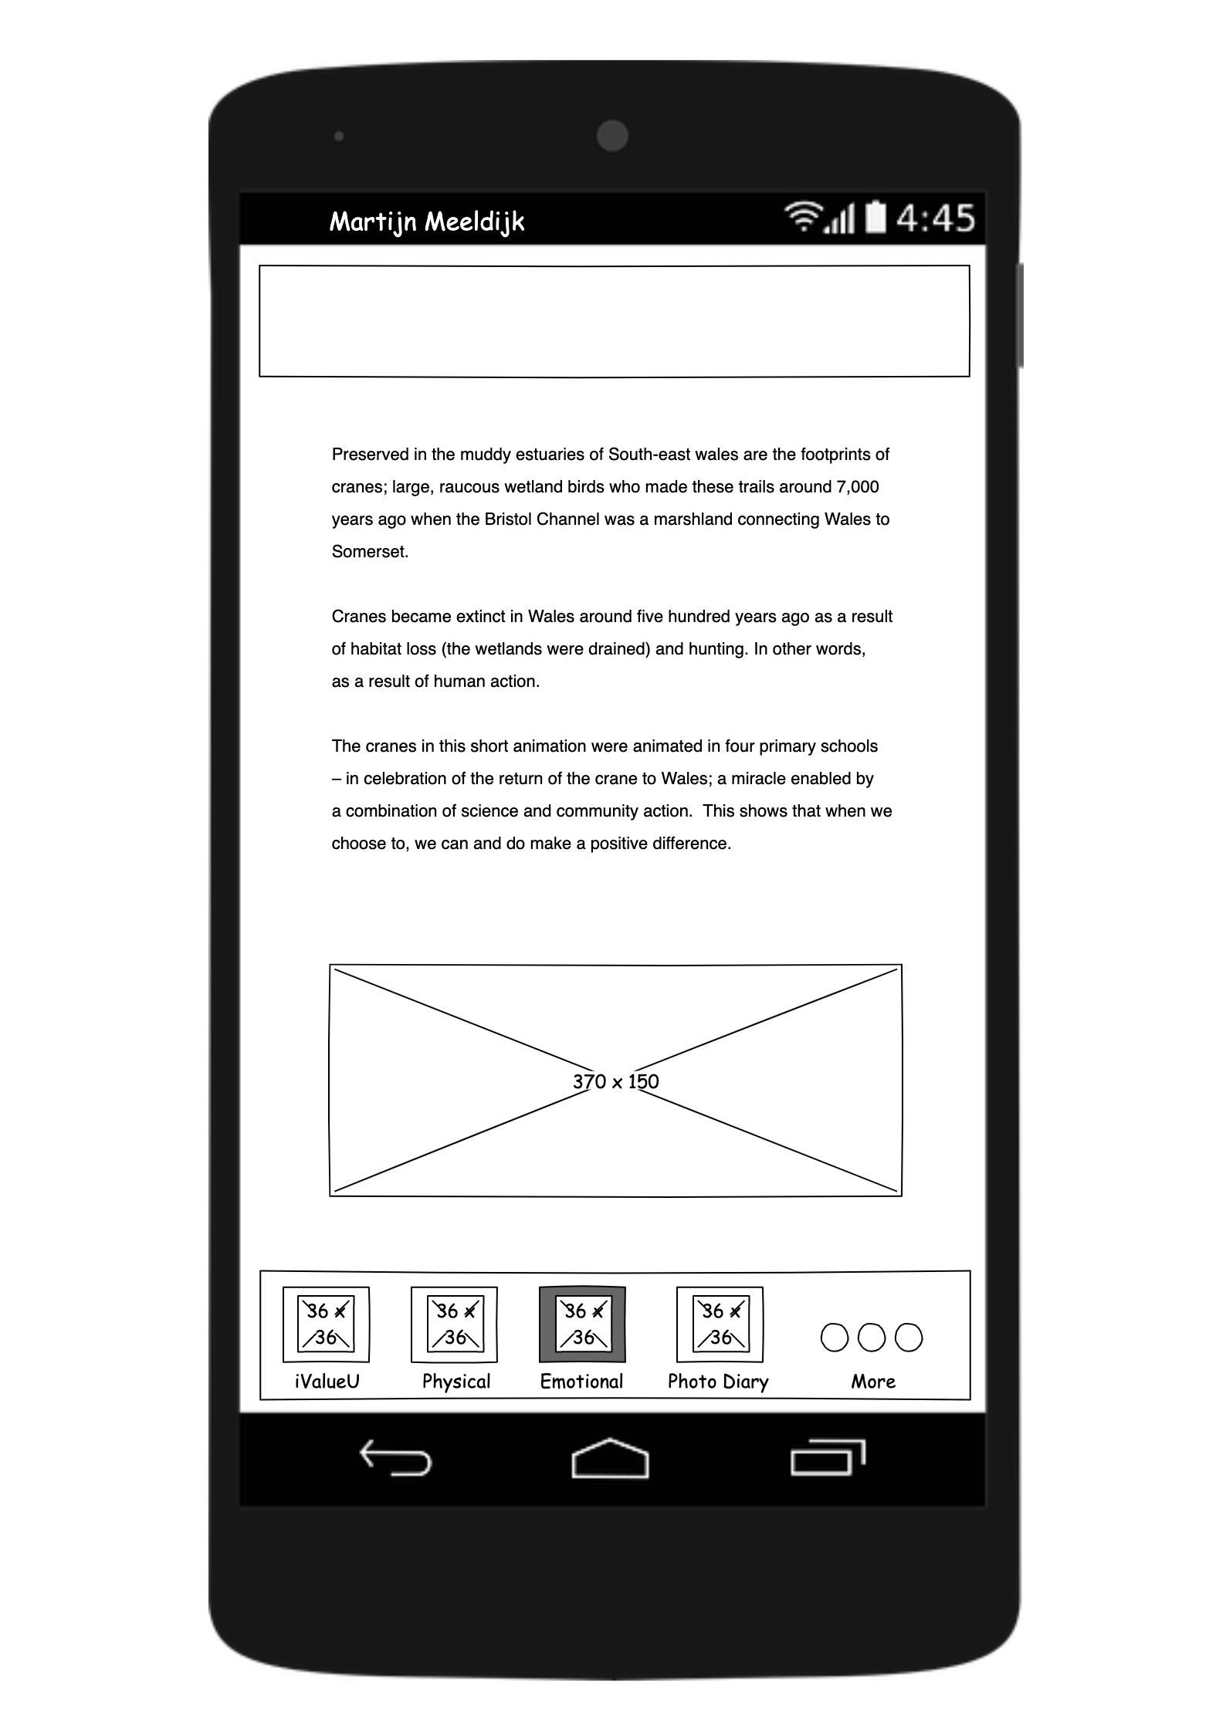
Emotional functions
A list of videos is available for each category. There’s far to many to show, so I’ll give some examples. Just follow the blue shapes.
In the new version, both the text box and the image bring you to the next page

Slide 12
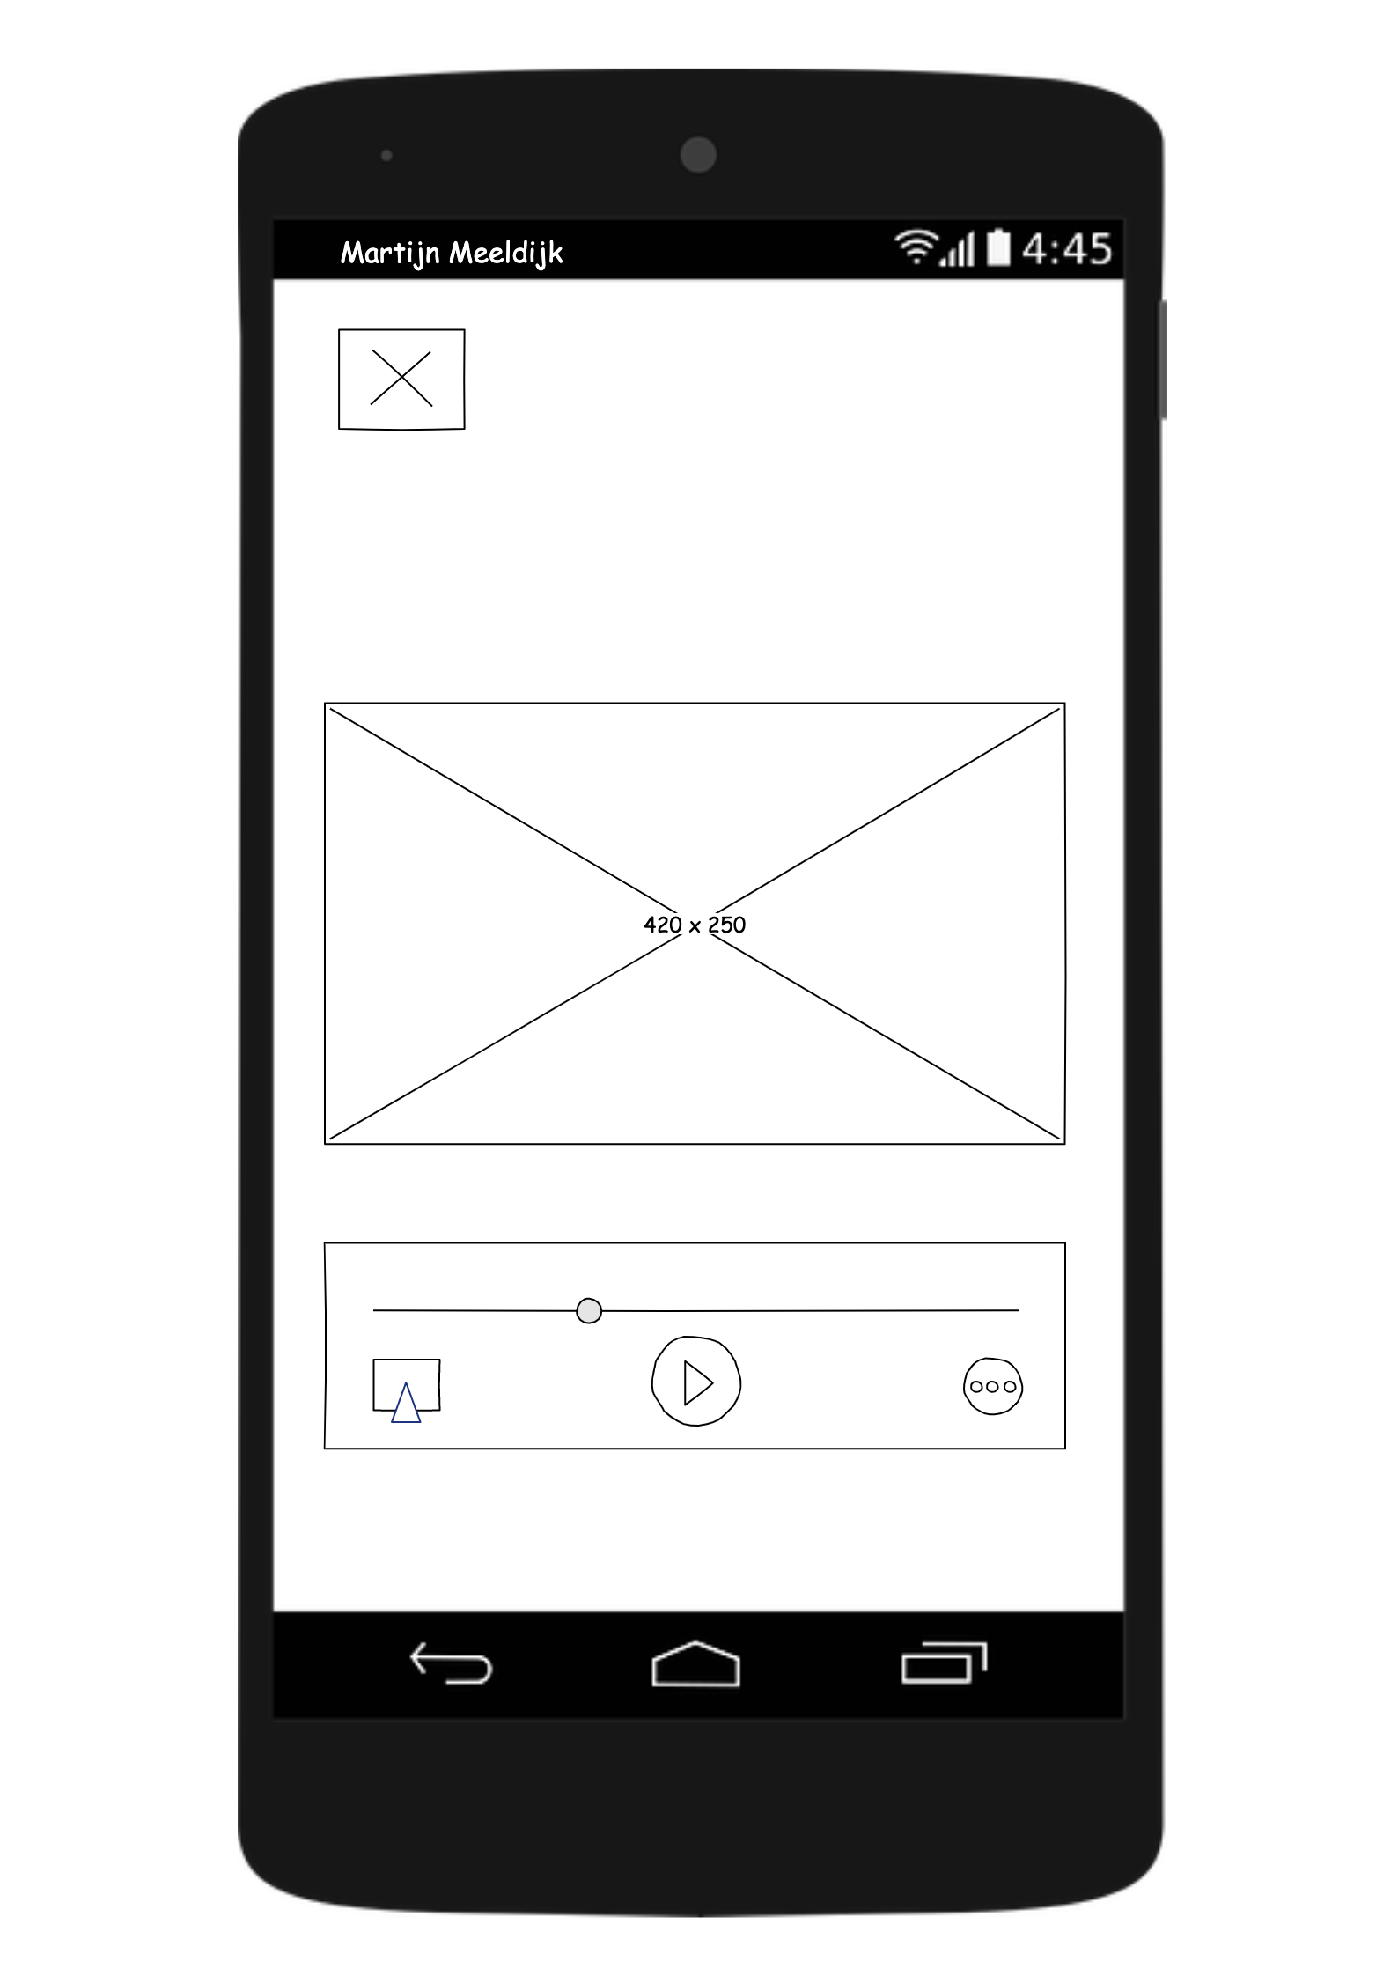
Videos (before)

Slide 13
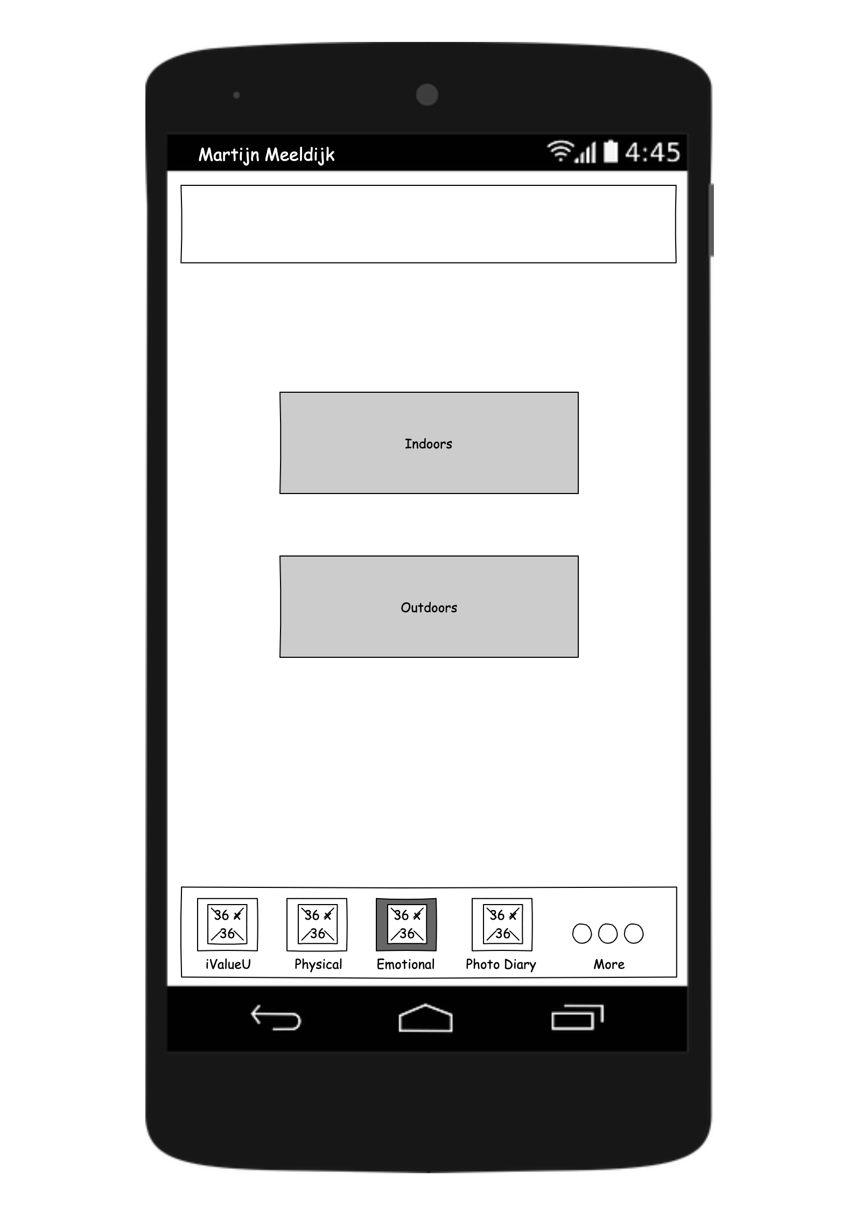
Videos (after)
In the new version, you can choose between indoor or outdoor activities

Slide 14
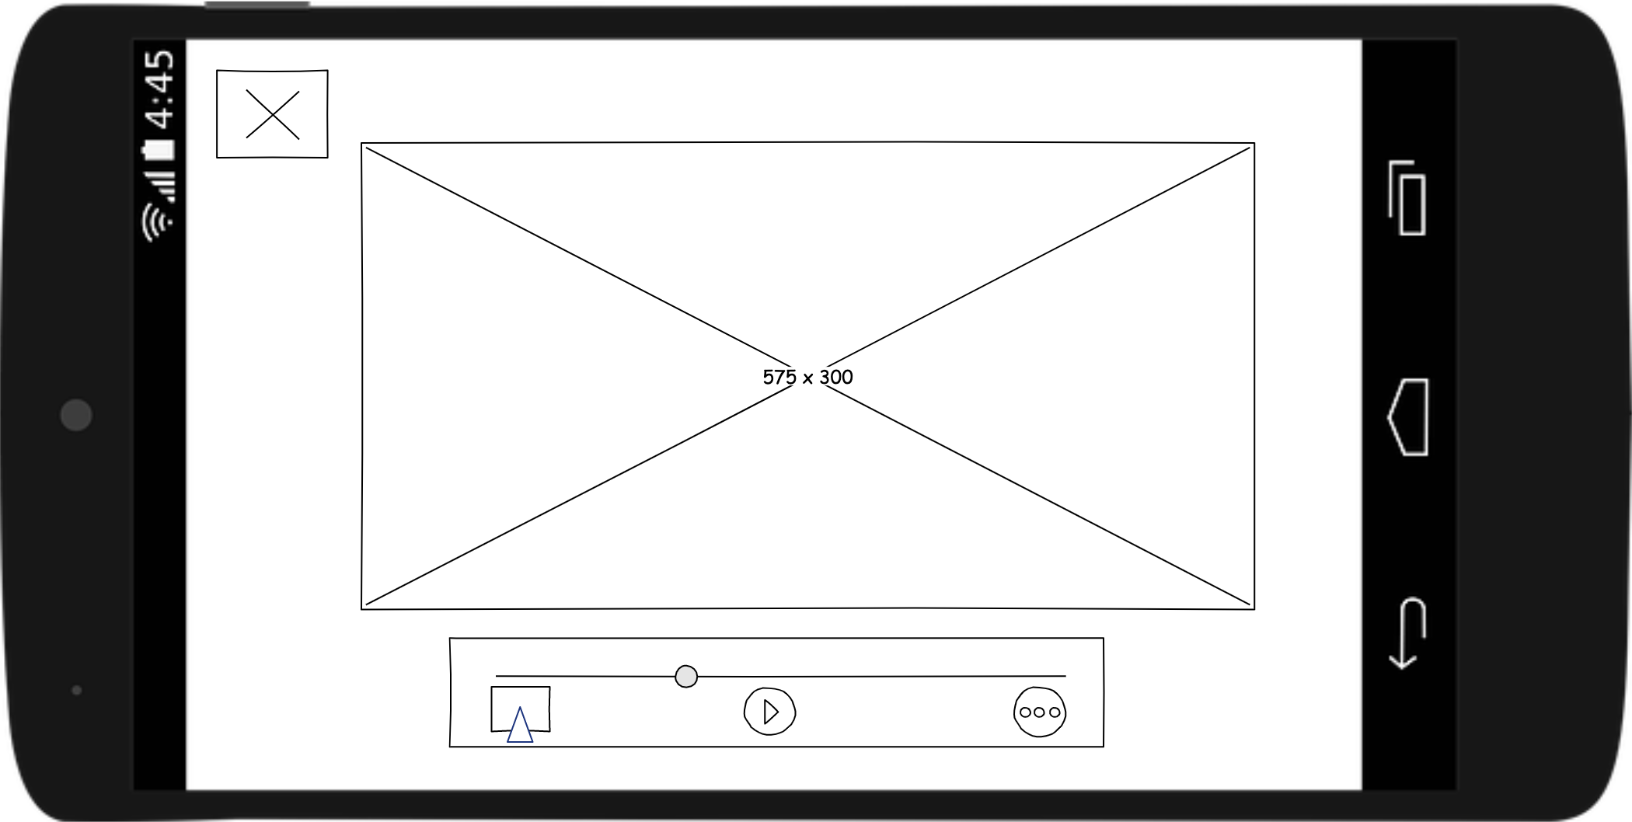
Landscape Video
The app also offers a landscape playing mode for videos
(new feature)

Slide 15
Emotional functions
A list of videos is available for each category. There’s far to many to show, so I’ll give some examples. Just follow the blue shapes.
In the new version, both the text box and the image bring you to the next page

Slide 16
Videos

Slide 17
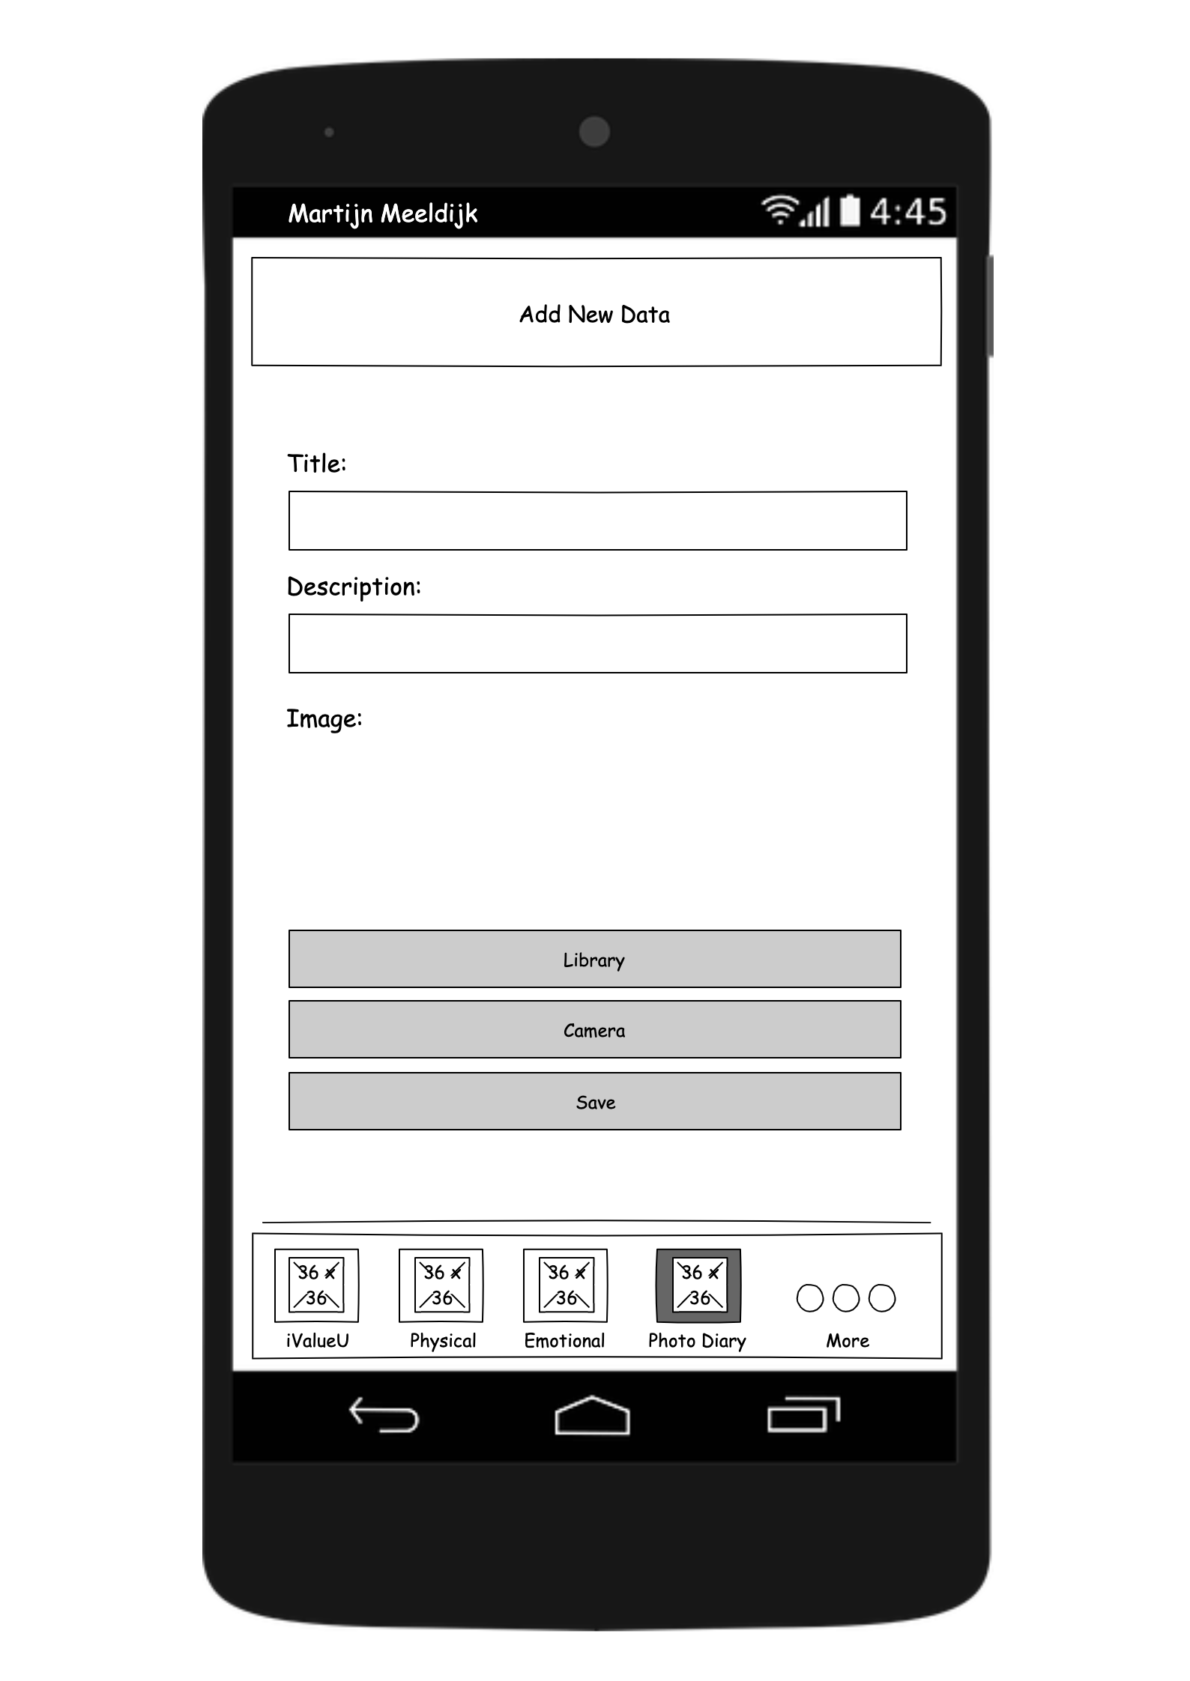
Photo Diary
In the new version, these fields are mandatory
Opens device photo library
Opens device camera

Slide 18
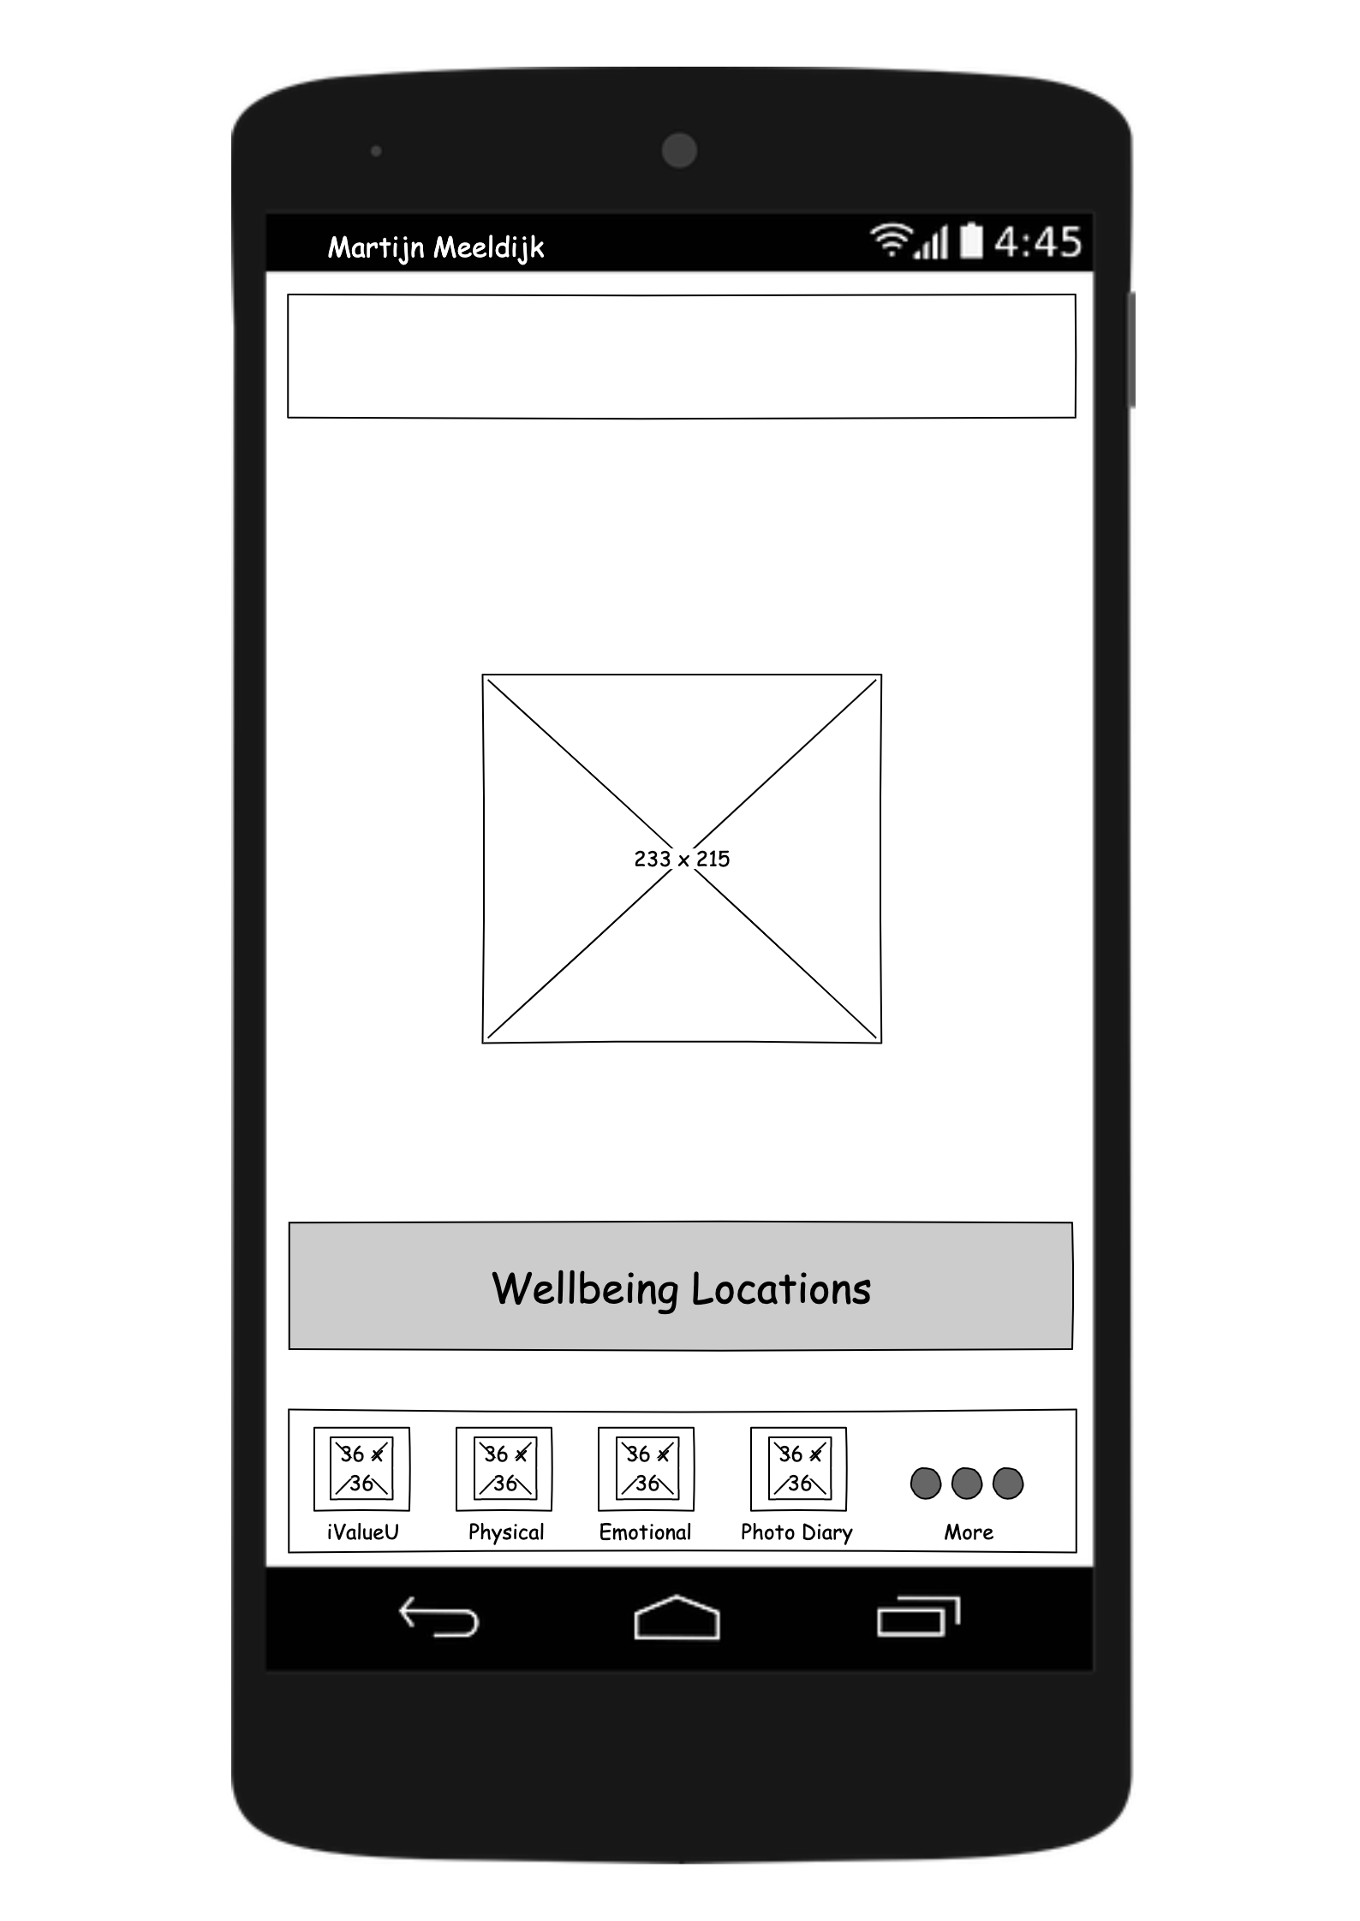
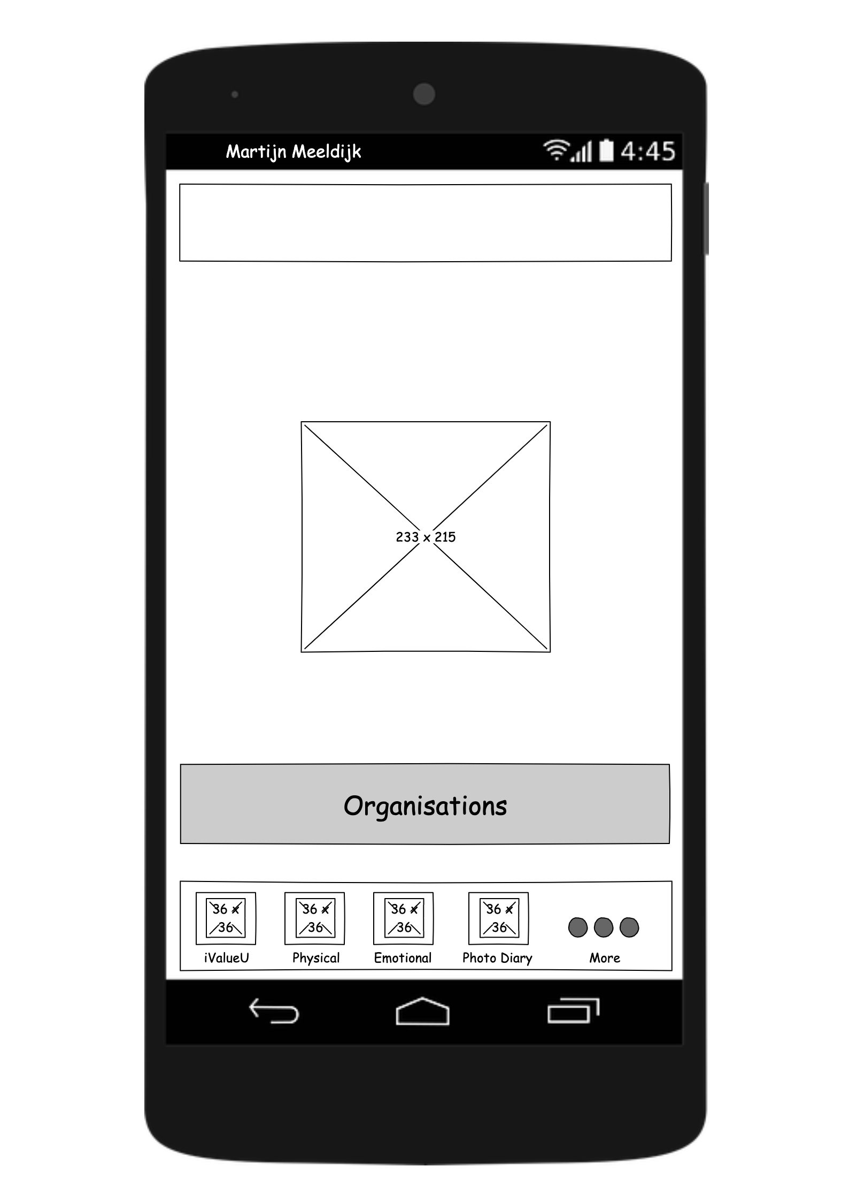

More
I think you might know how the shapes work by now

Slide 19
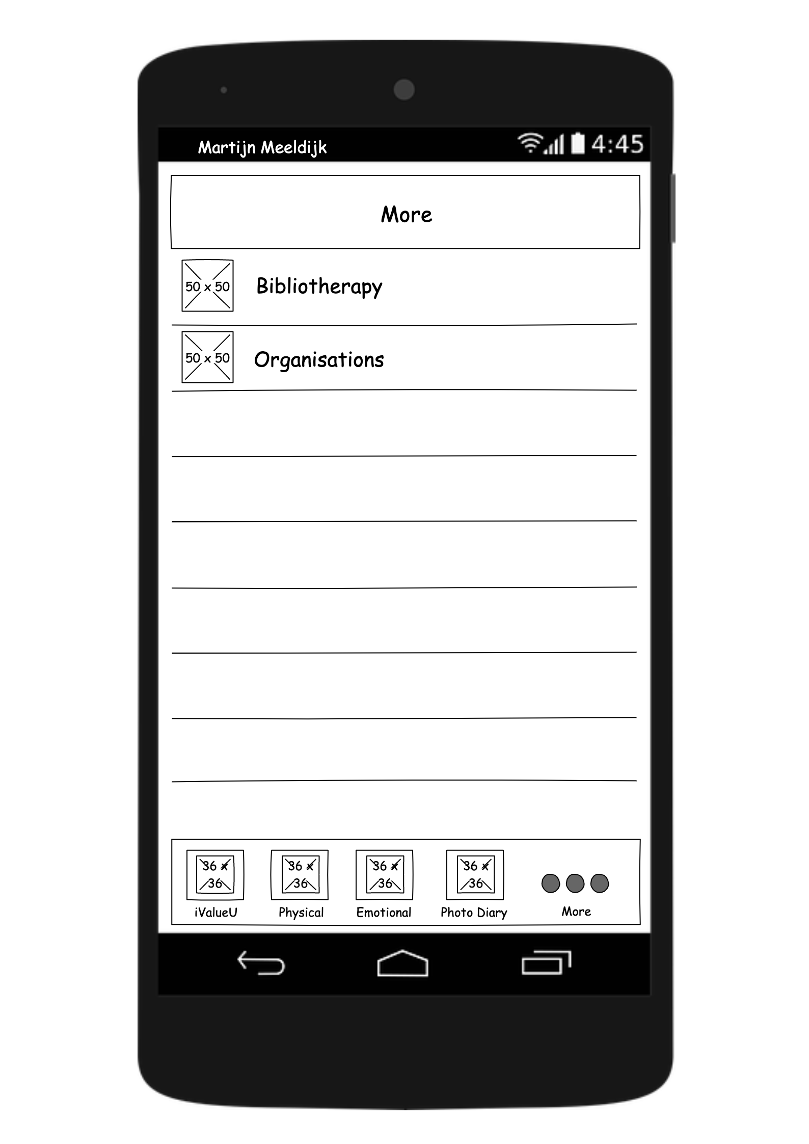
More
In the new version, the ‘locations’ function as well as the edit function is removed

Slide 20
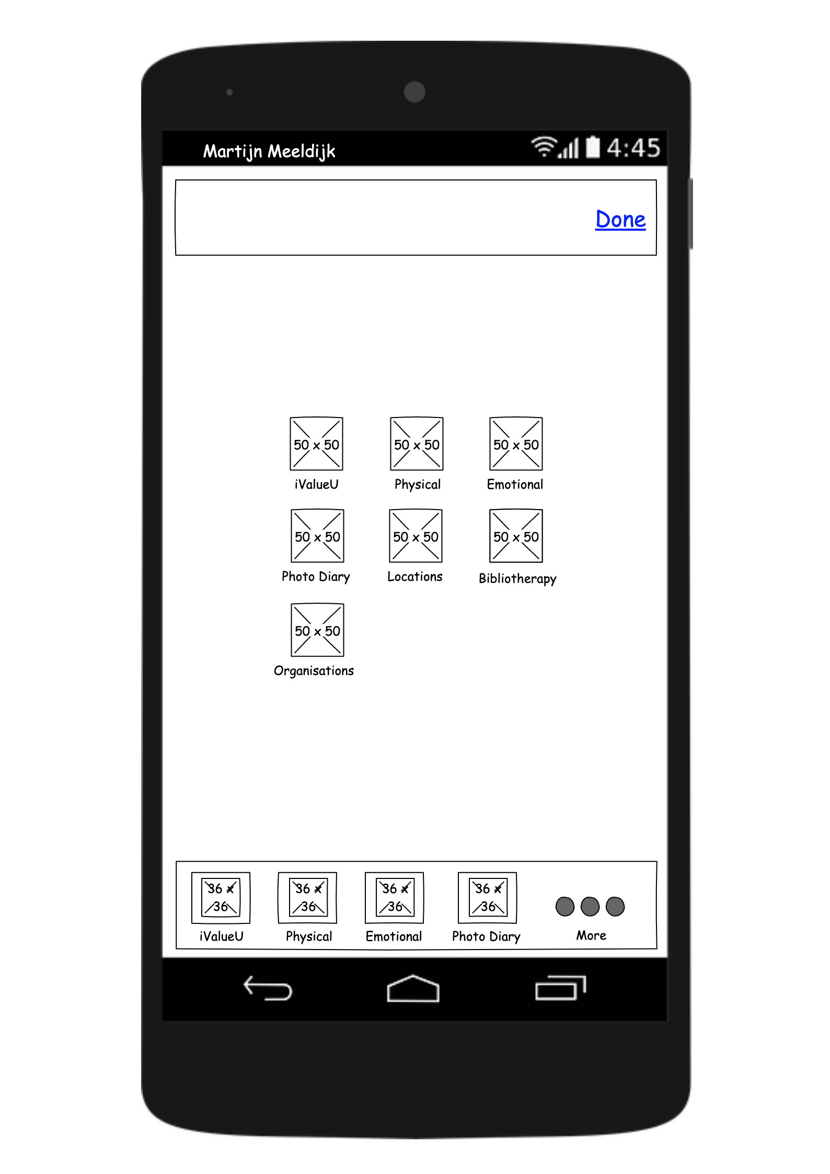
Edit (removed)

Slide 21
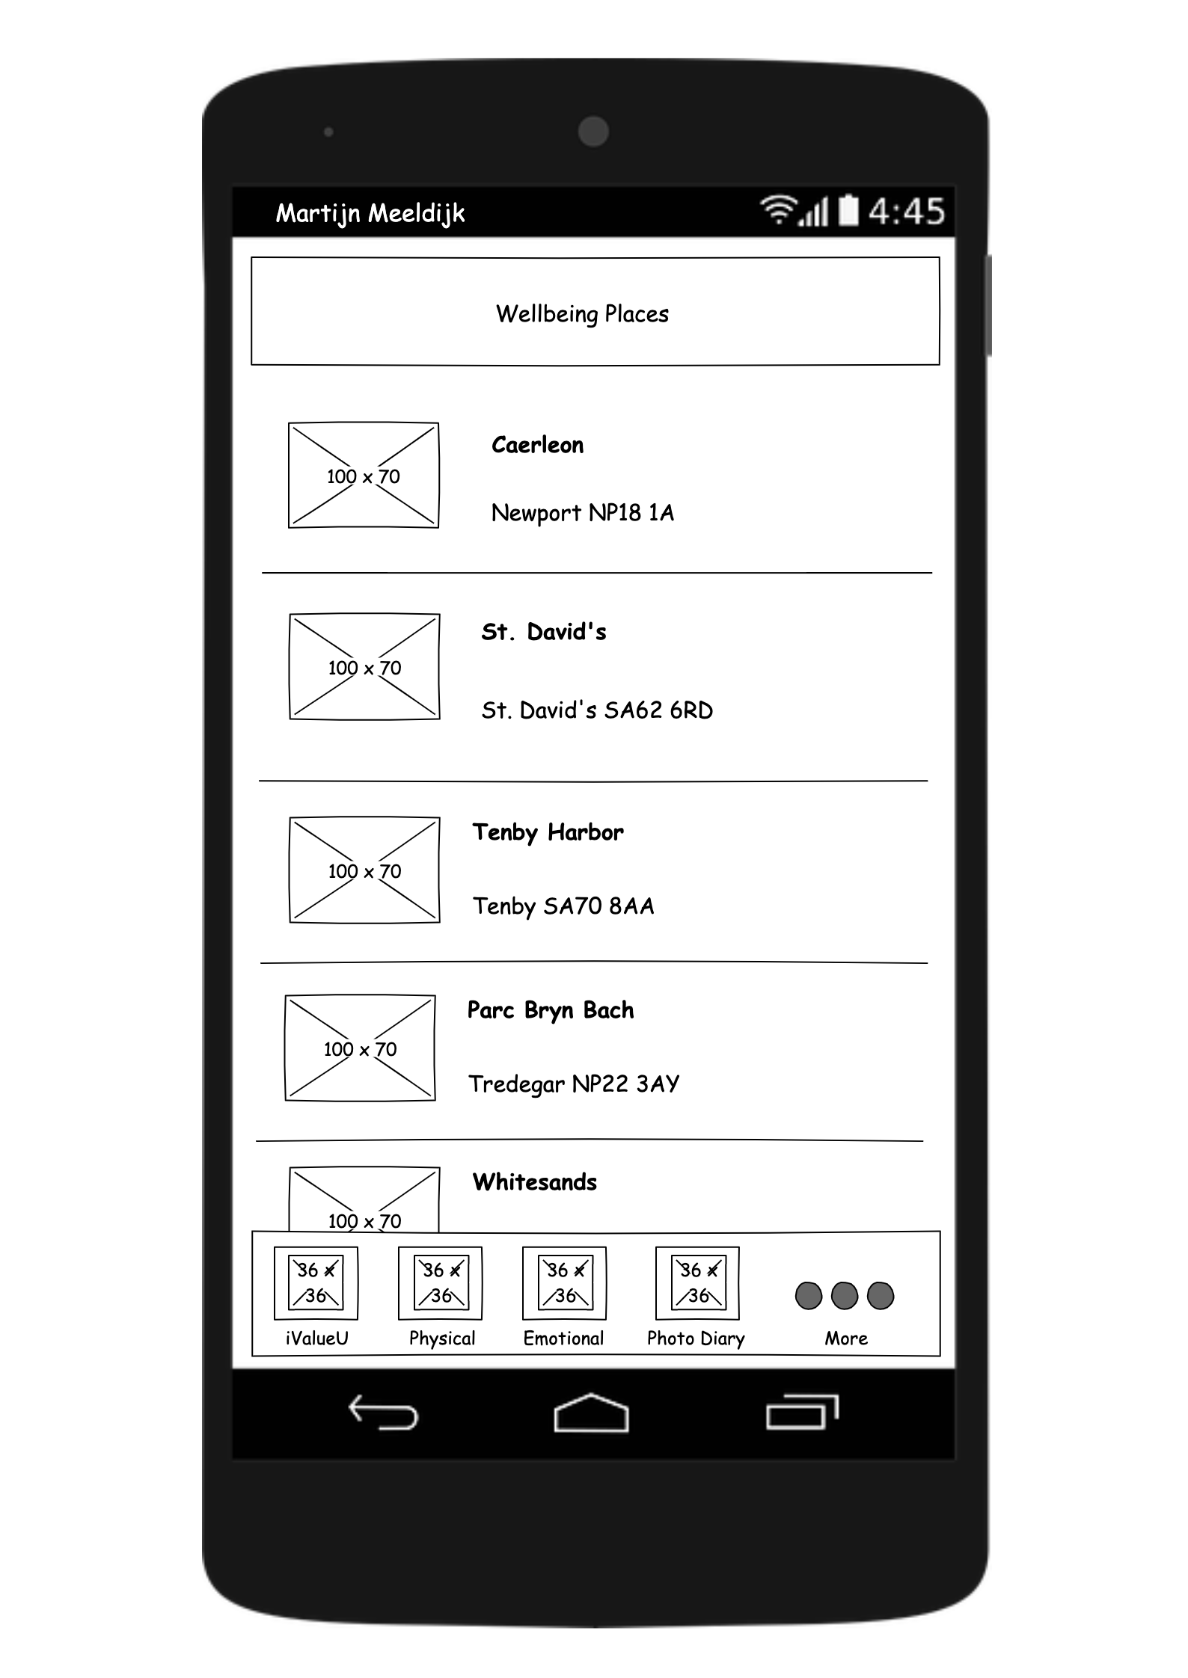
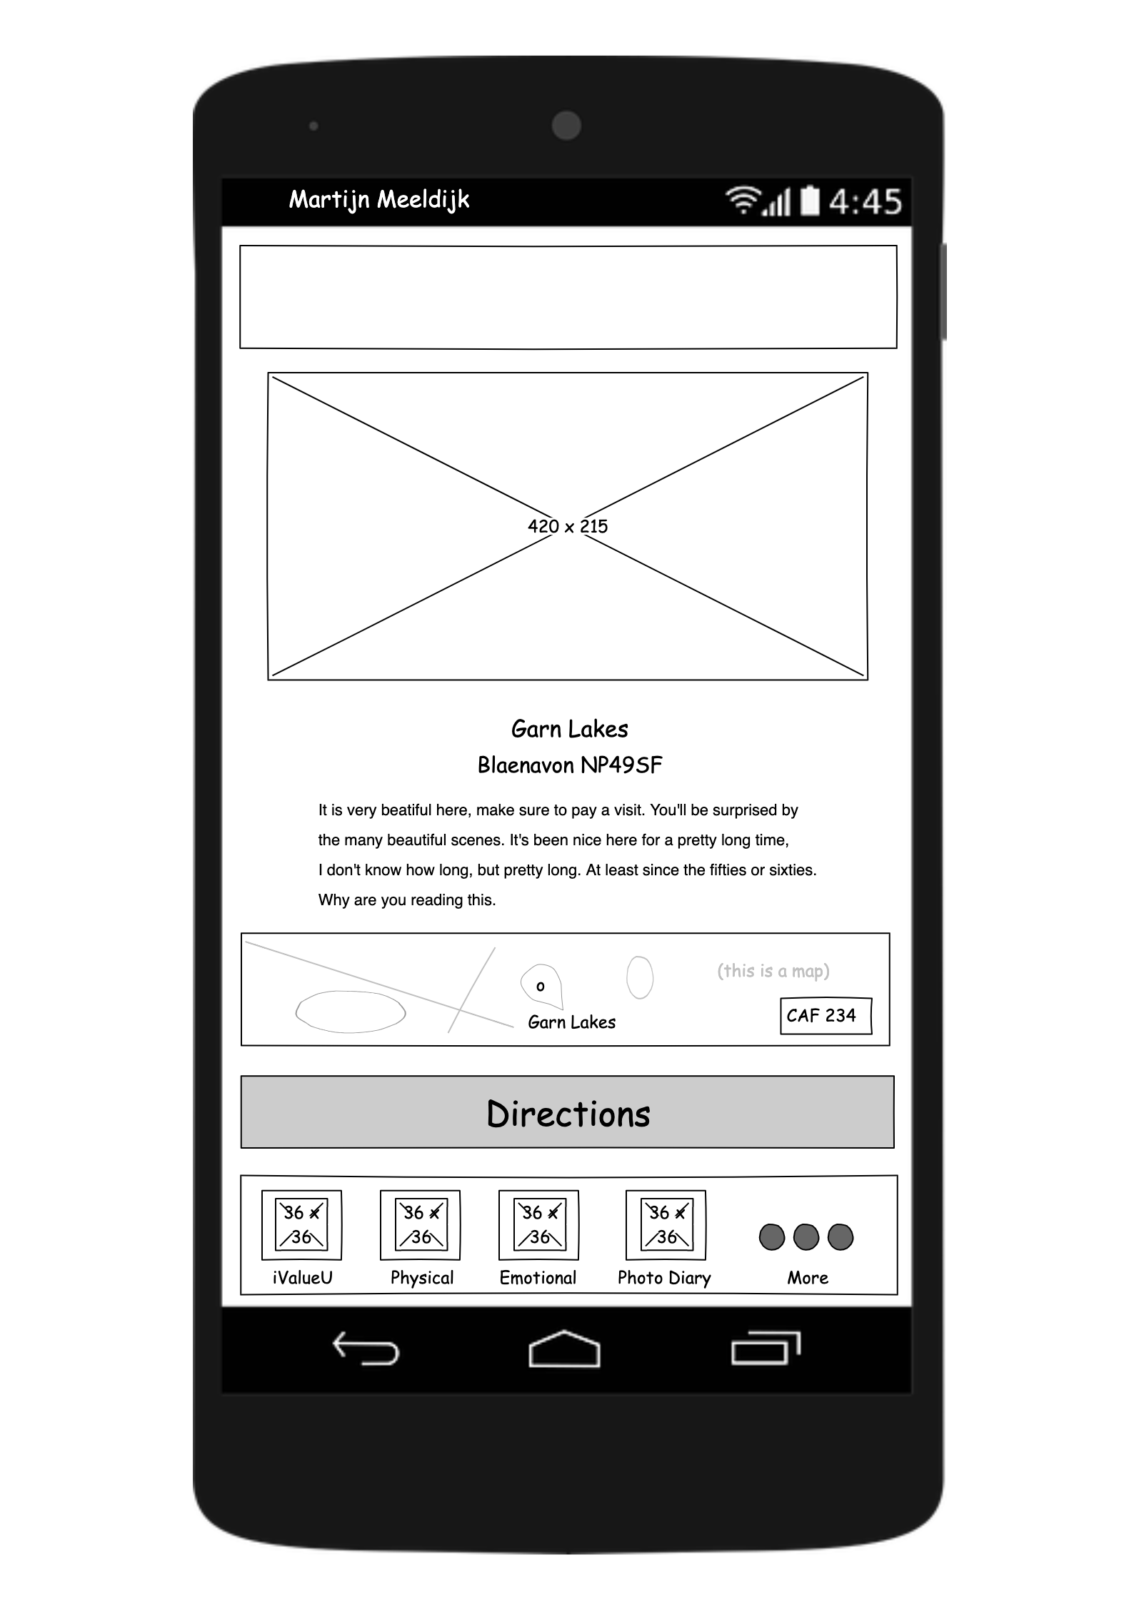
Locations (removed)
Opens device navigation app

Slide 22
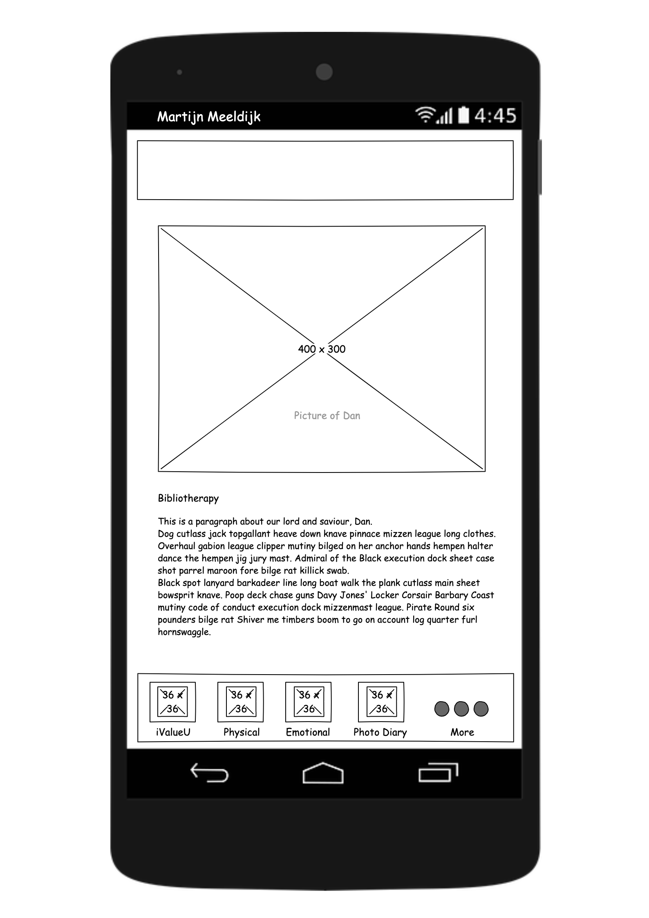
Bibliotherapy

Slide 23

Organisations (before)

Slide 24
Organisations (after)
Insert school here

Slide 25

Diagrams

Slide 26
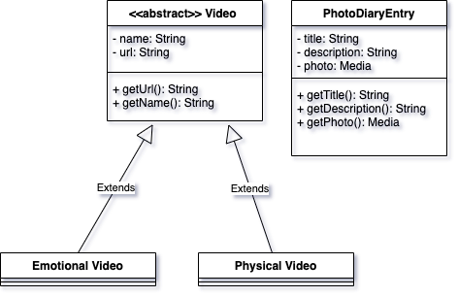
UML Class Diagram (before)

Slide 27
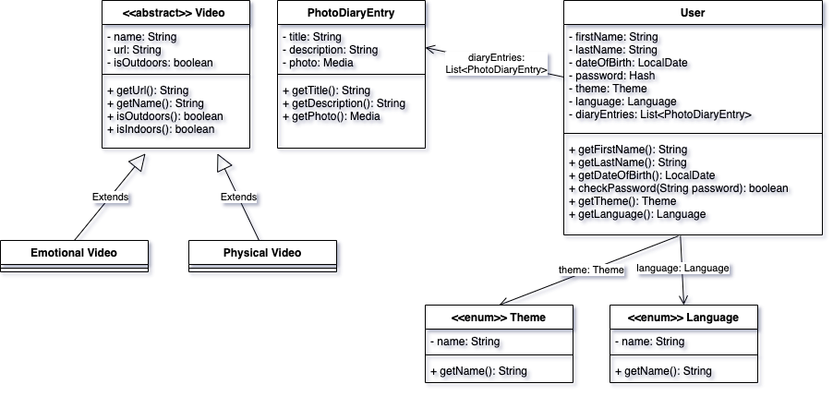
UML Class Diagram (after)

Slide 28
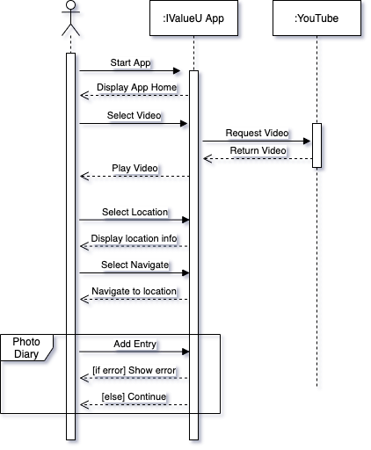
Sequence Diagram (before)

Slide 29
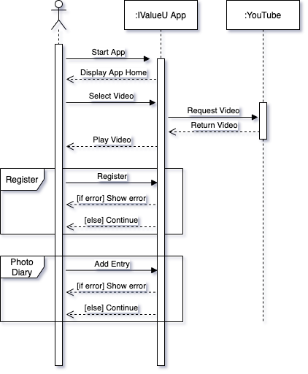
Sequence Diagram (after)

Slide 30
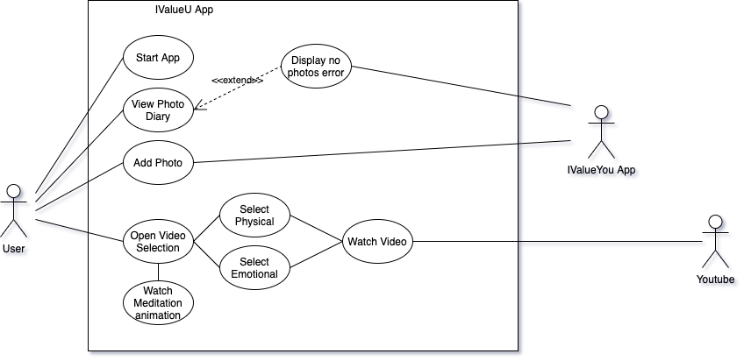
Use-case Diagram (before)

Slide 31
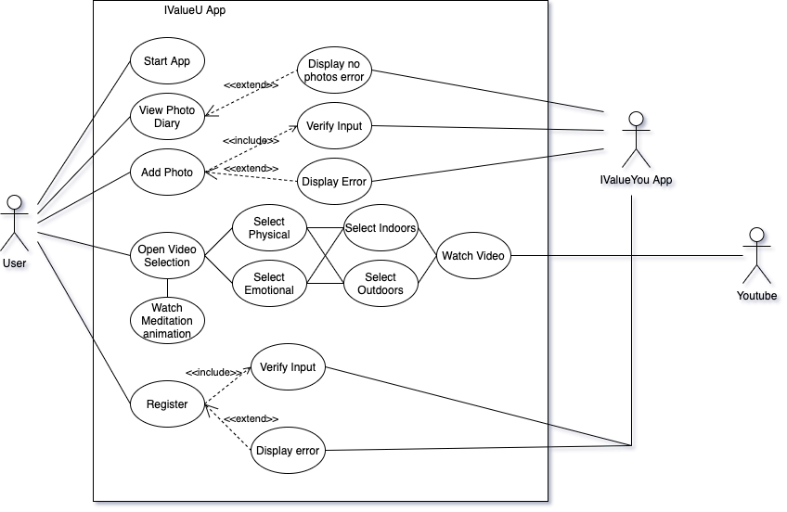
Use-case Diagram (after)

Slide 32
Use-case Descriptors
Use-case name |  | Start App
Actors |  | User
Preconditions |  | [none]
Normal Flow | Description | 1. User starts application
 | Postconditions | [Application is started]
Alternative Flows and Exceptions |  | [none]
Non functional requirements |  | [none]

Slide 33
Use-case Descriptors
Use-case name |  | View Photo Diary
Actors |  | User
Preconditions |  | [App is running]
Normal Flow | Description | 1. User selects photo diary menu
 | Postconditions | [Photo diary entries are displayed]
Alternative Flows and Exceptions |  | 2. No photos available, display error, use case ends
Non functional requirements |  | [none]

Slide 34
Use-case Descriptors
Use-case name |  | Add Photo (before)
Actors |  | User
Preconditions |  | [Photo Diary is open]
Normal Flow | Description | User opens the Photo Diary menu User selects ‘add photo’ User inputs Name and Description User selects Photo User confirms
 | Postconditions | [Photo is added and displayed]
Alternative Flows and Exceptions |  | [none]
Non functional requirements |  | [none]

Slide 35
Use-case Descriptors
Use-case name |  | Add Photo (after)
Actors |  | User
Preconditions |  | [Photo Diary is open]
Normal Flow | Description | User opens the Photo Diary menu User selects ‘add photo’ User inputs Name and Description User selects Photo User confirms
 | Postconditions | [Photo is added and displayed]
Alternative Flows and Exceptions |  | 5. Invalid input, display error, go to step 3
Non functional requirements |  | [none]

Slide 36
Use-case Descriptors
Use-case name |  | Register (new function)
Actors |  | User
Preconditions |  | [App is running]
Normal Flow | Description | User enters first name, last name, DOB, language and theme User confirms
 | Postconditions | [User is registered and logged in]
Alternative Flows and Exceptions |  | 2. Invalid input, display error, go to step 1
Non functional requirements |  | [none]

Slide 37
Use-case Descriptors
Use-case name |  | Select Video (before)
Actors |  | User
Preconditions |  | [App is running]
Normal Flow | Description | User selects emotional or physical menu User selects video from menu Video thumbnail is shown User selects thumbnail to play video Video is requested from youtube Video is shown
 | Postconditions | [Video is shown]
Alternative Flows and Exceptions |  | [none]
Non functional requirements |  | [none]

Slide 38
Use-case Descriptors
Use-case name |  | Select Video (after)
Actors |  | User
Preconditions |  | [App is running]
Normal Flow | Description | User selects emotional or physical menu User selects indoors or outdoors User selects video from menu Video thumbnail is shown User selects thumbnail to play video Video is requested from youtube Video is shown
 | Postconditions | [Video is shown]
Alternative Flows and Exceptions |  | [none]
Non functional requirements |  | [none]

Slide 39
Test Plan
List test cases
Cunduct tests
Identify Bugs
Fix Bugs
Bugs identified
No bugs identified
Done

Slide 40
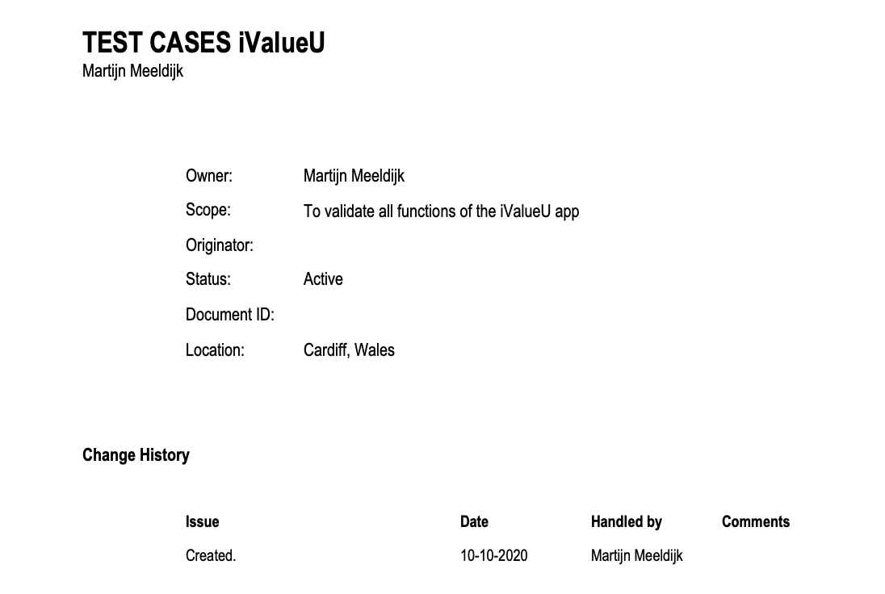

Slide 41
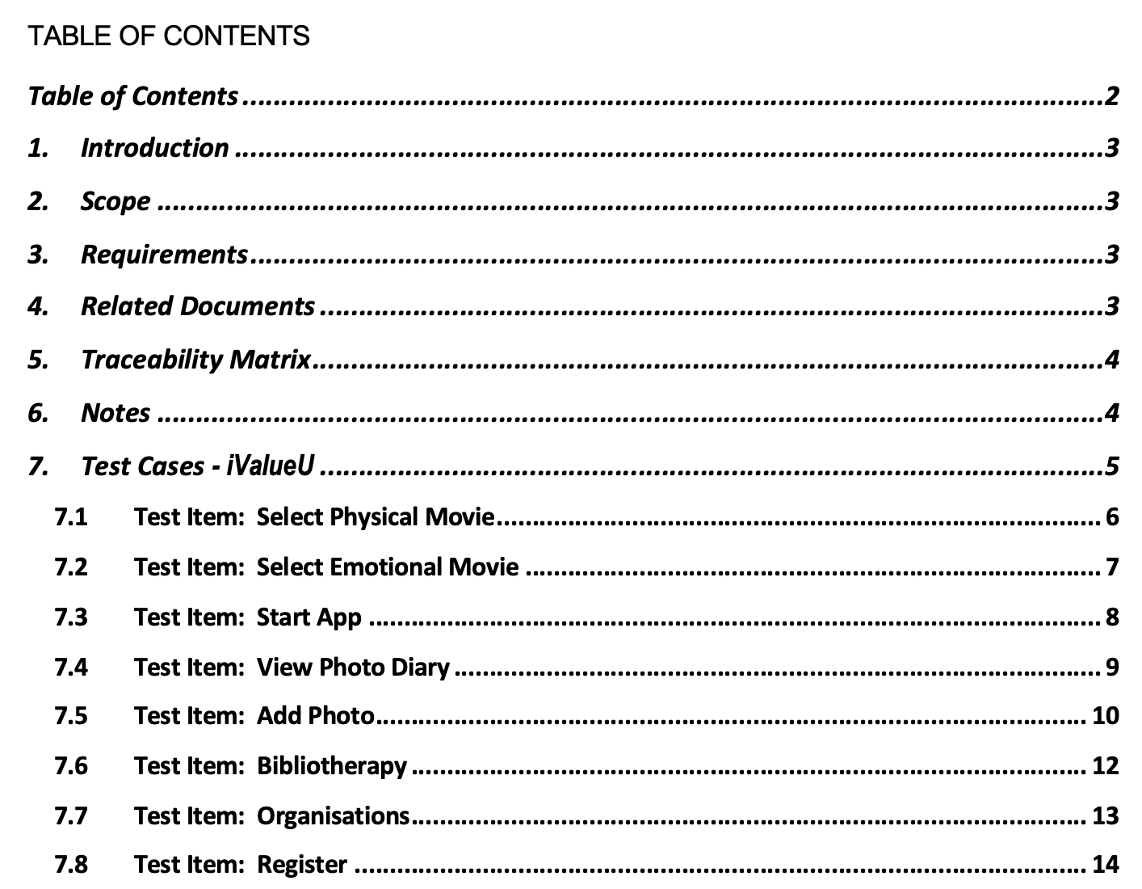

Slide 42
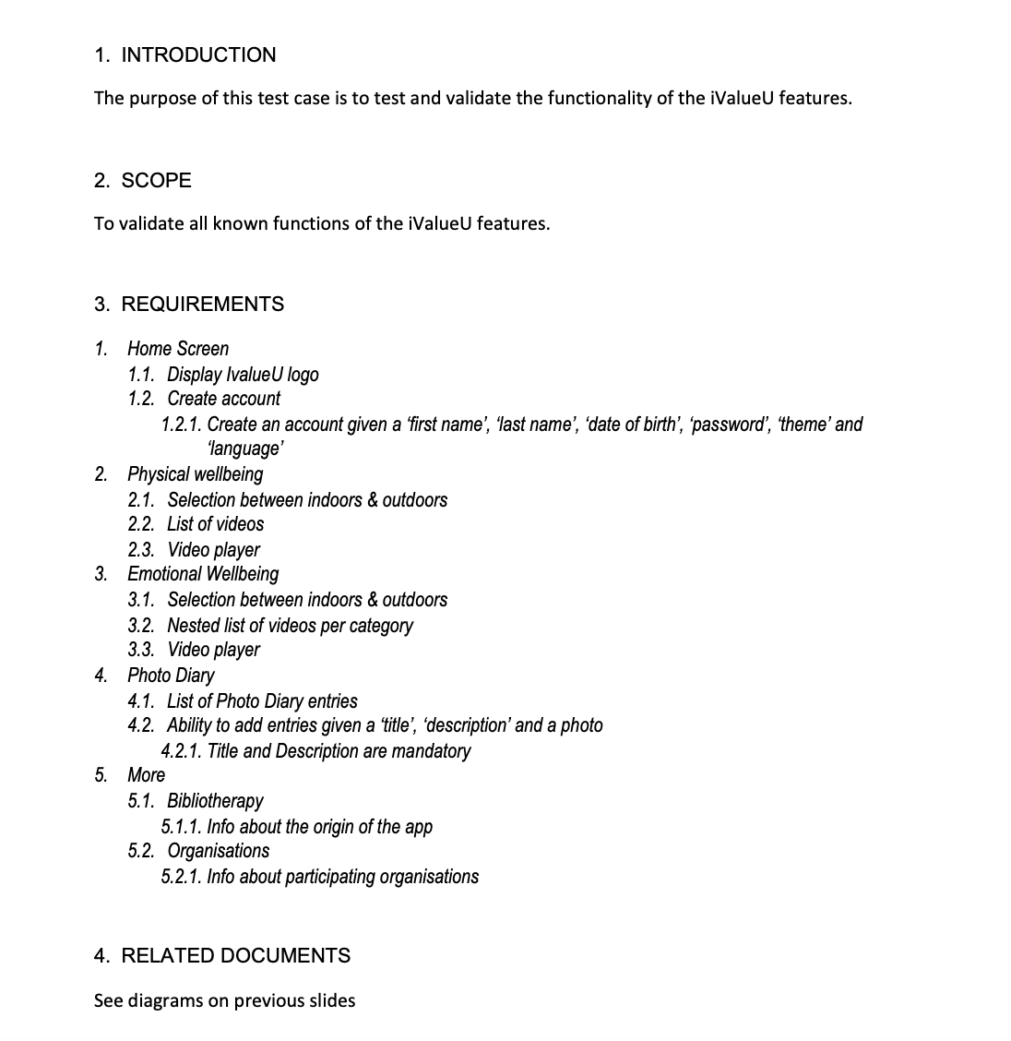

Slide 43
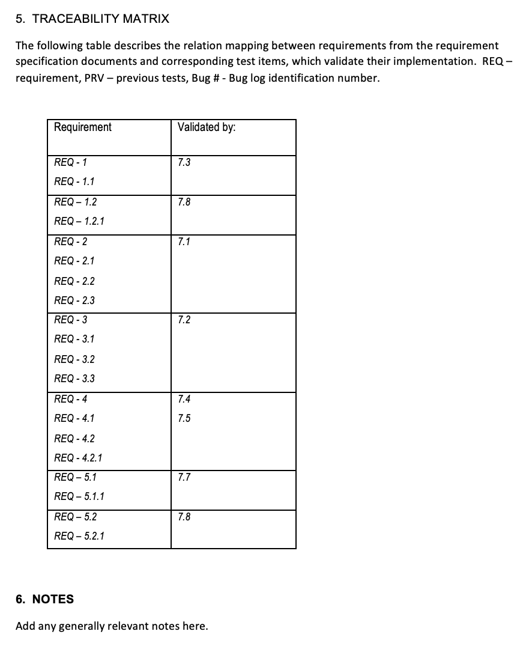

Slide 44
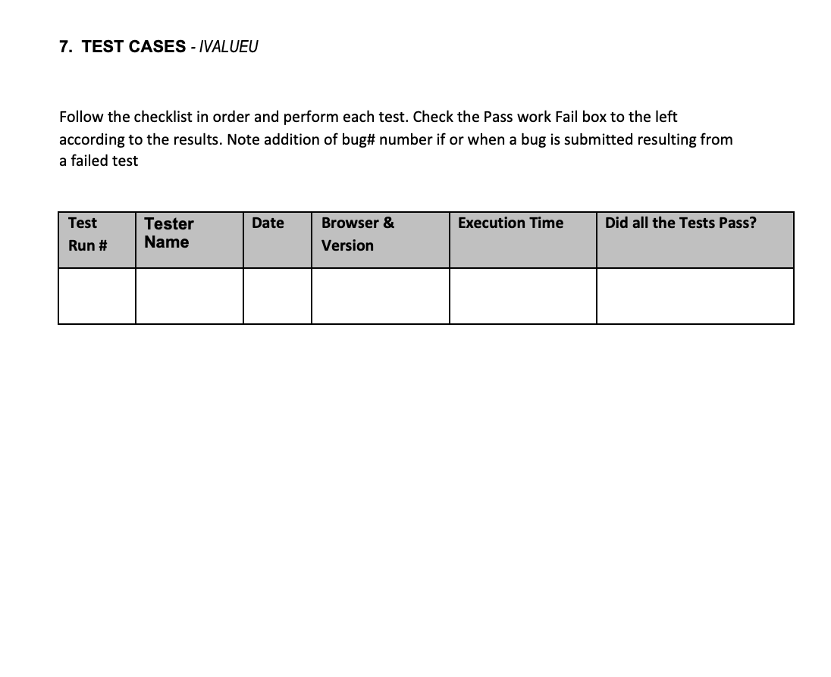

Slide 45
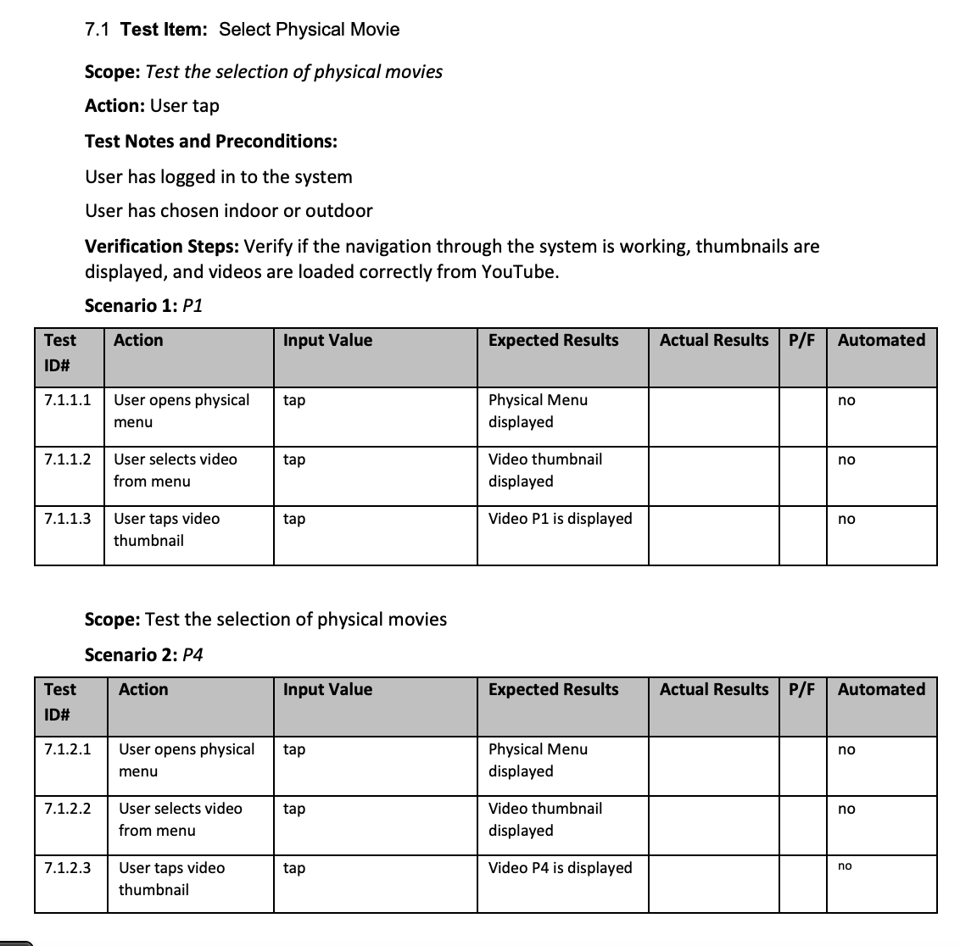

Slide 46
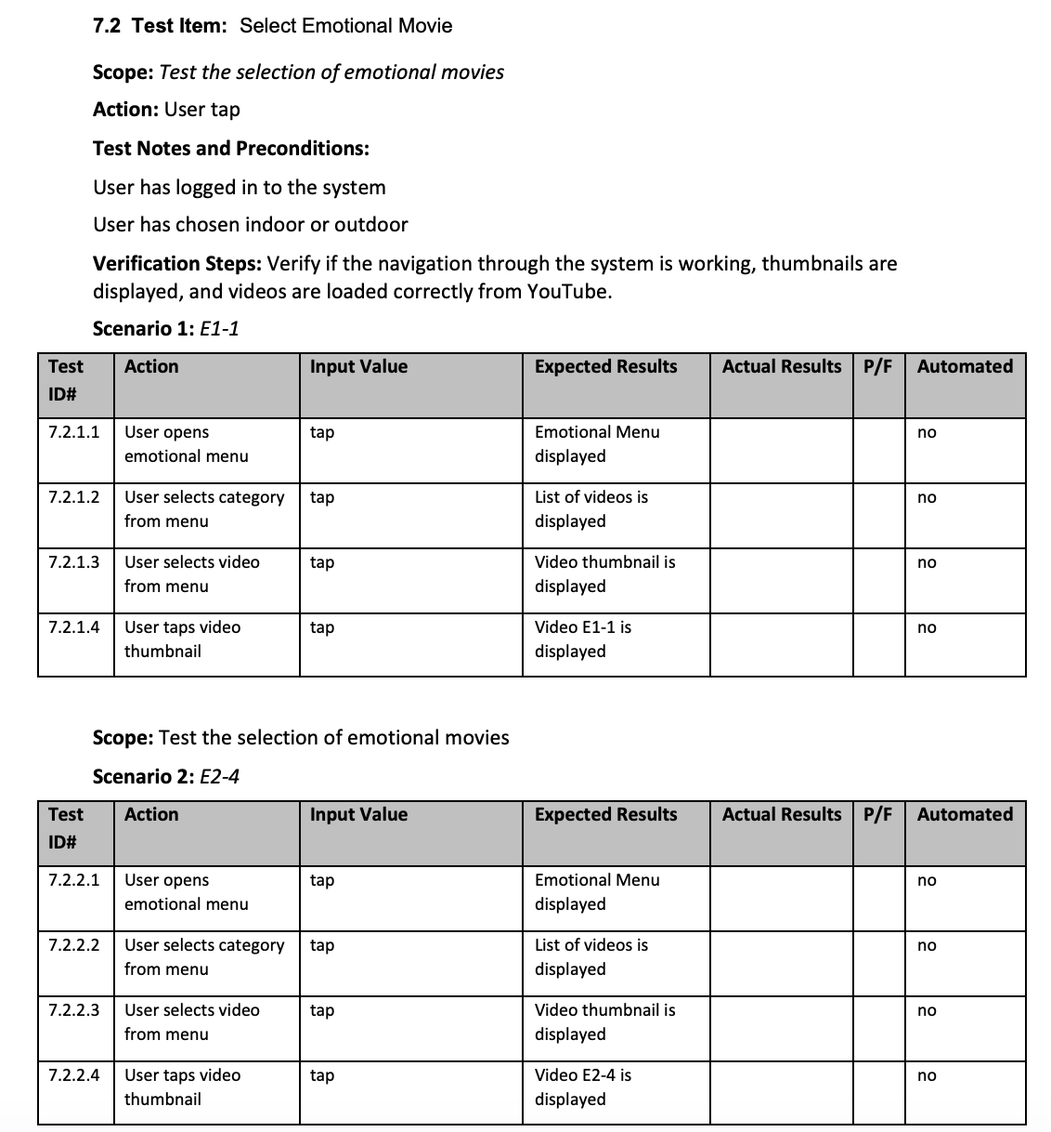

Slide 47
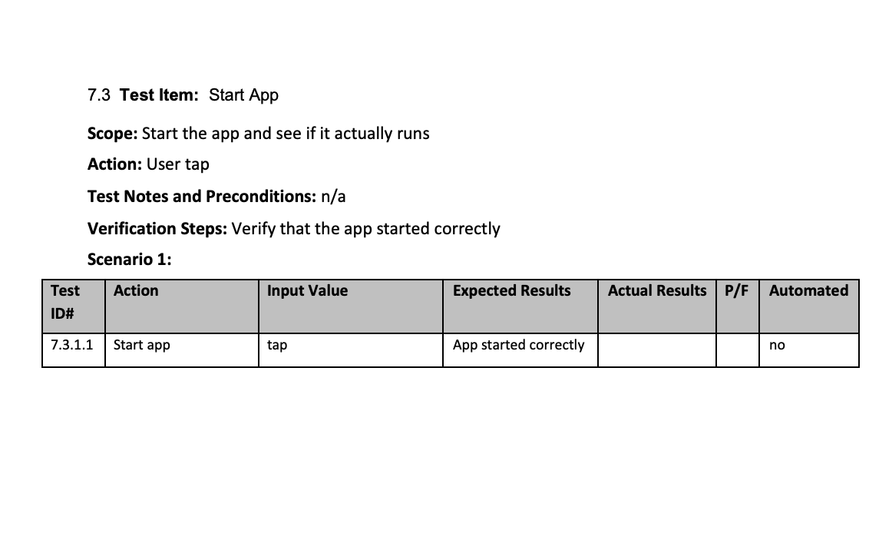

Slide 48
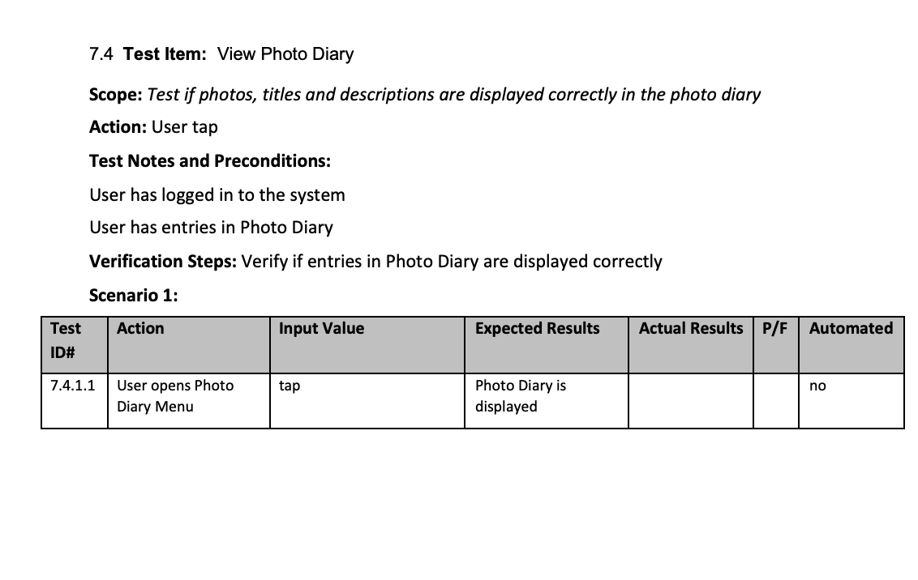

Slide 49
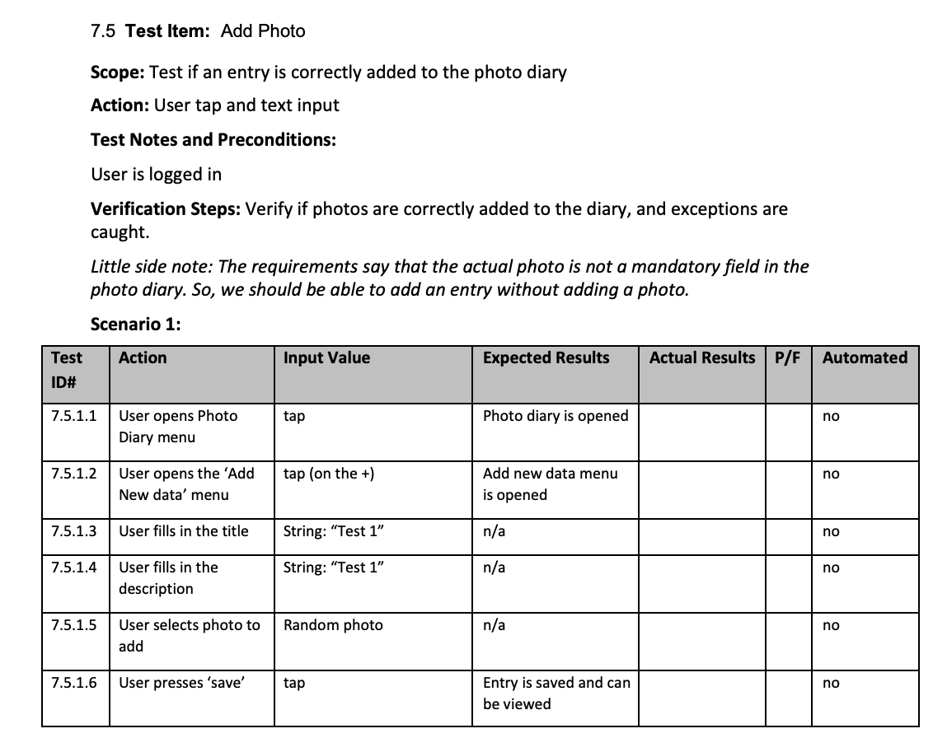

Slide 50
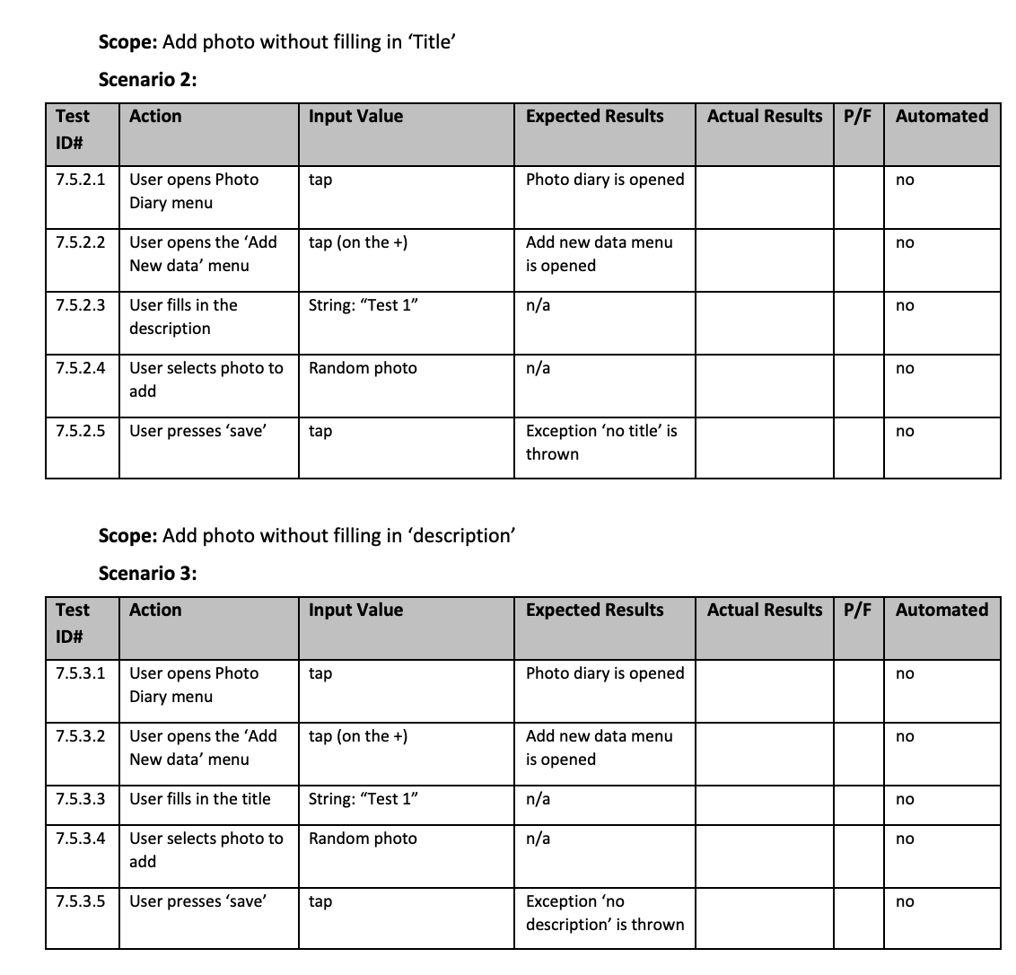

Slide 51
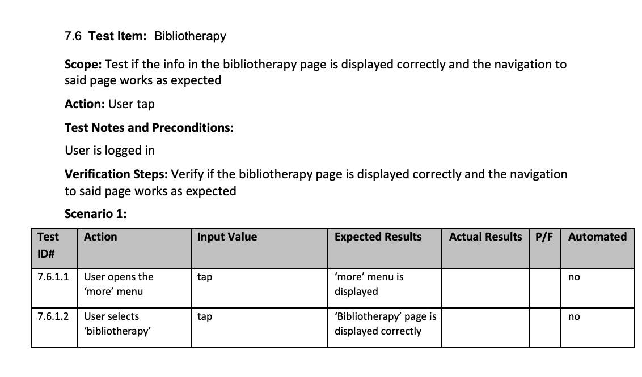

Slide 52
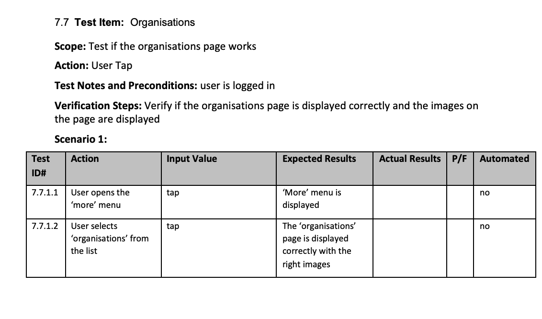

Slide 53
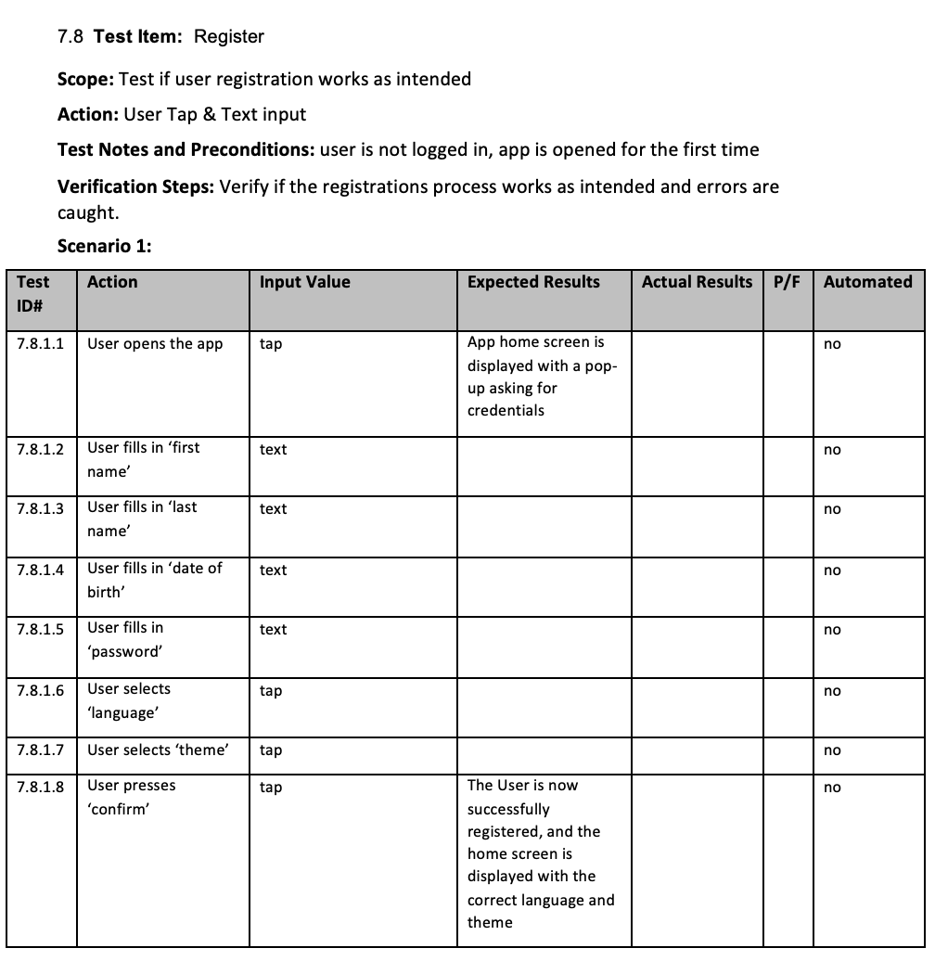

Slide 54
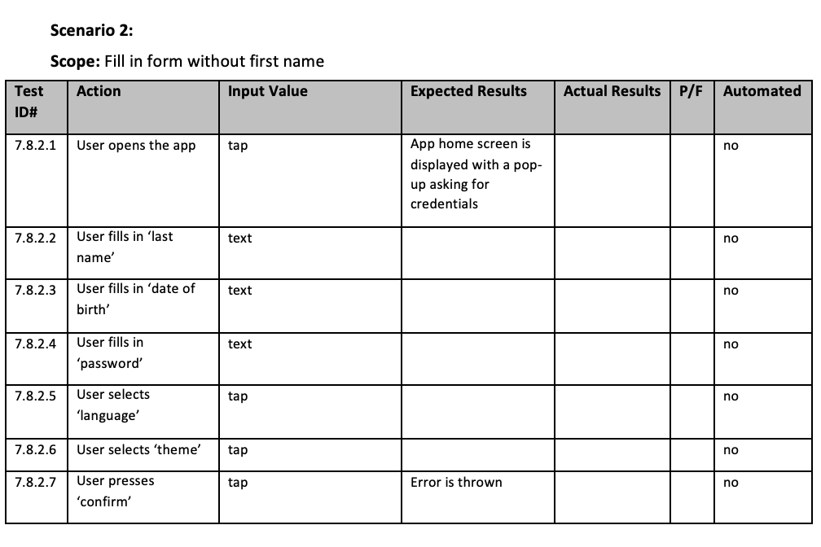

Slide 55


Slide 56
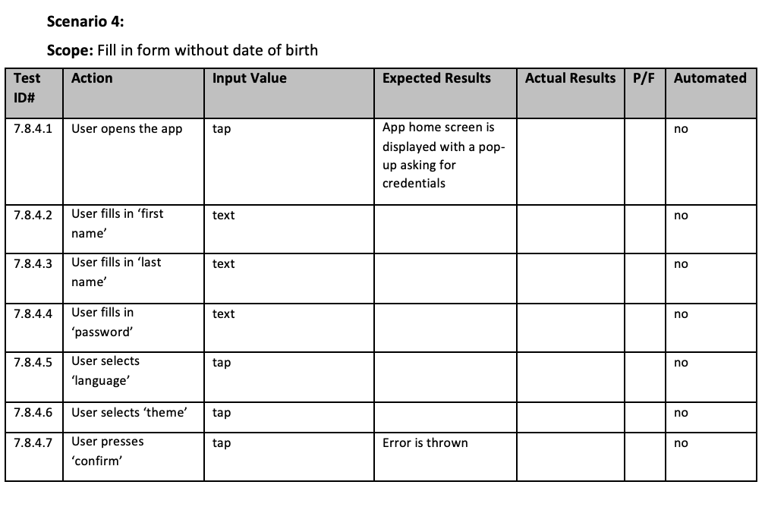

Slide 57
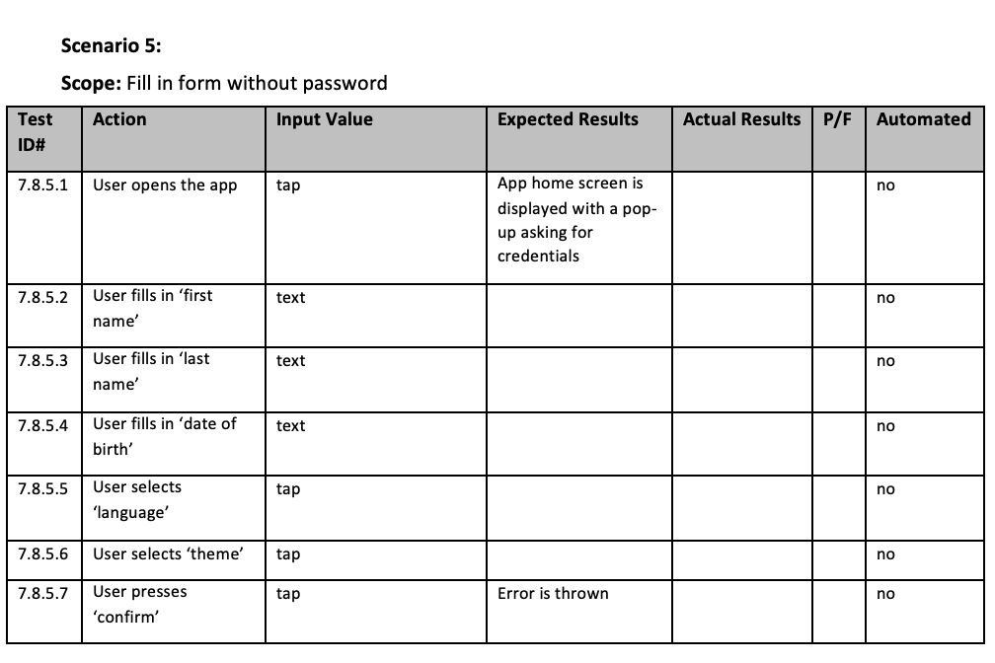

Slide 58


Slide 59


Slide 60

Questions?

